Slide 1
Drug (and alcohol) related deaths: statistics and beyond
Steve Taylor, Programme Manager, Alcohol, Drugs, Tobacco and Justice, PHE

Slide 2
2019 drug poisonings in England and Wales
4,393 deaths registered related to drug poisoning - highest number but …
Drug poisoning rates remain high, consistent with 2018 registration year
Two-thirds of drug poisonings are because of drug misuse
And three quarters of drug misuse deaths involve opioids
Source: Office for National Statistics - Deaths related to drug poisoning in England and Wales: 2019 registrations

Slide 3
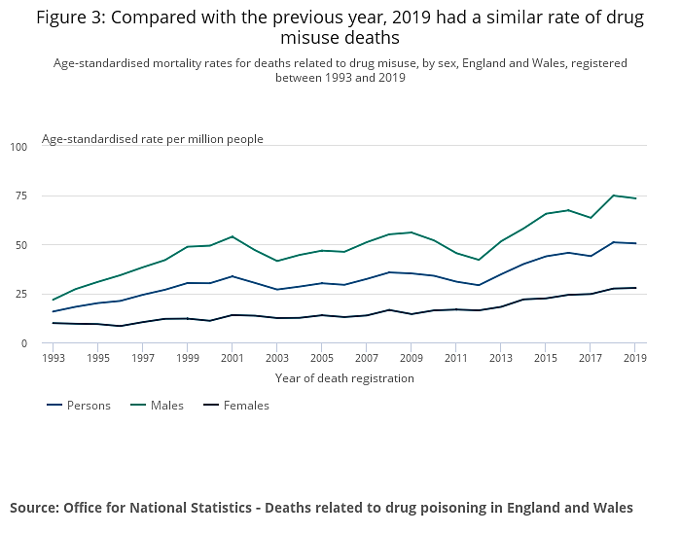
Drug misuse deaths rate stayed similar

Slide 4
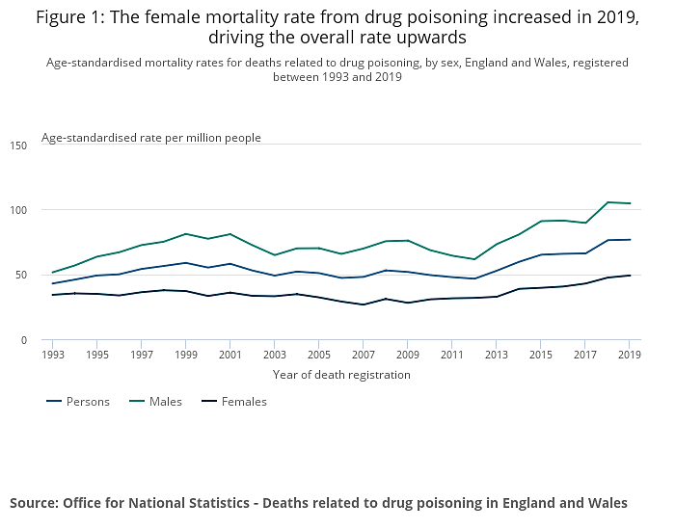
Female poisonings rate increased, driving up the overall

Slide 5
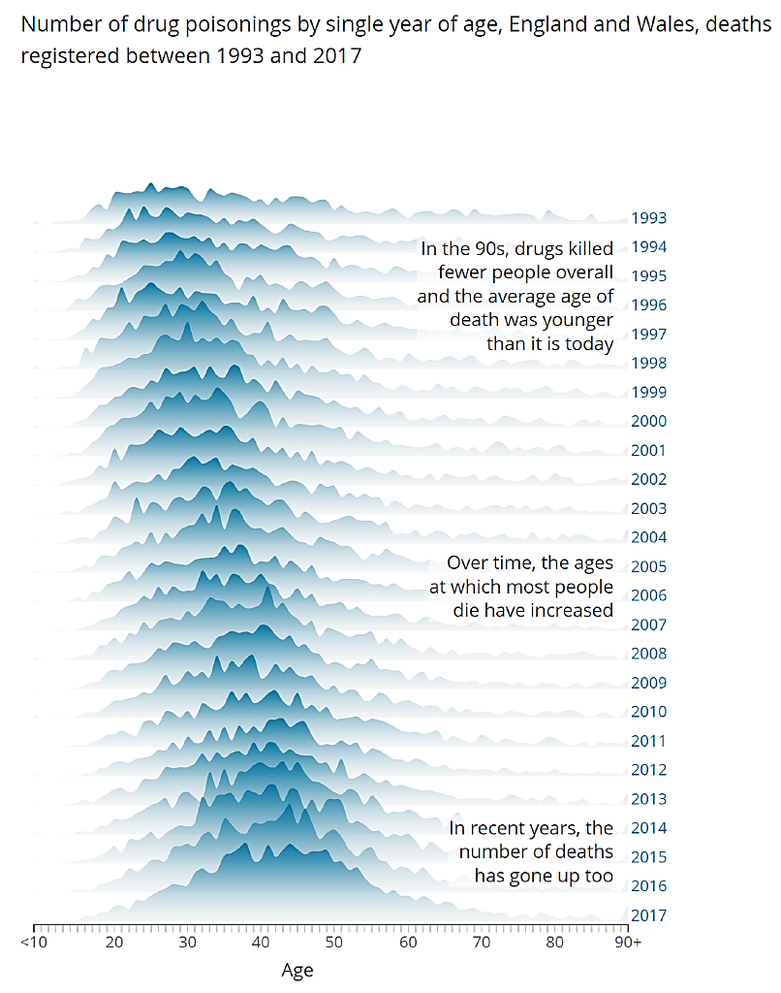
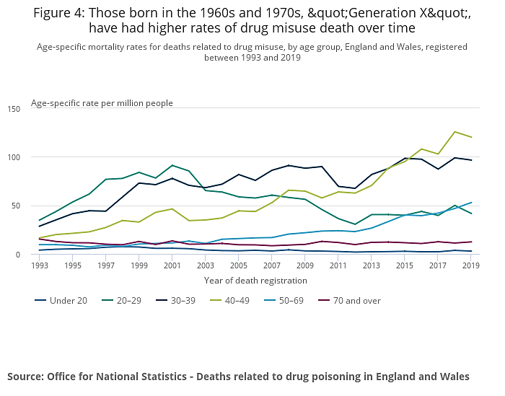
People born in the 60s and 70s have higher rates

Slide 6
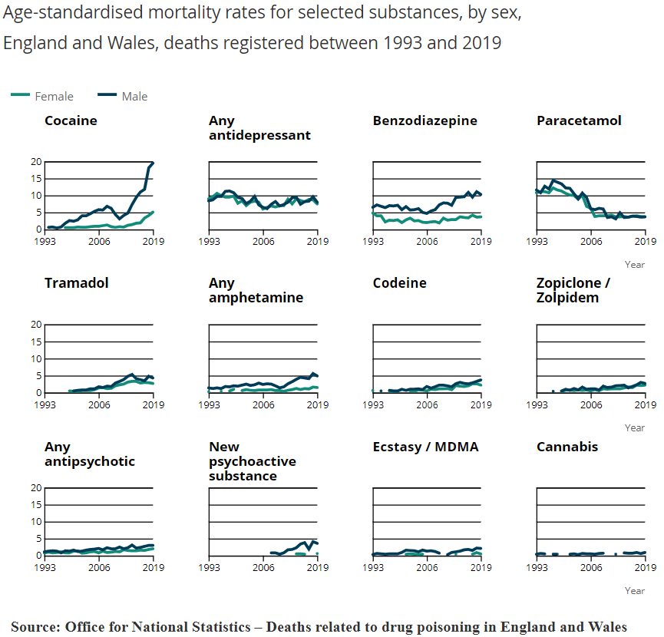
Trends are different for different substances
In 2019:
Deaths involving cocaine increased for the eighth successive year to their highest level
Deaths involving new psychoactive substances (NPS) remained stable
In the longer term:
Increases in benzos, amphetamines, some medicines (antipsychotics, z-drugs)

Slide 7
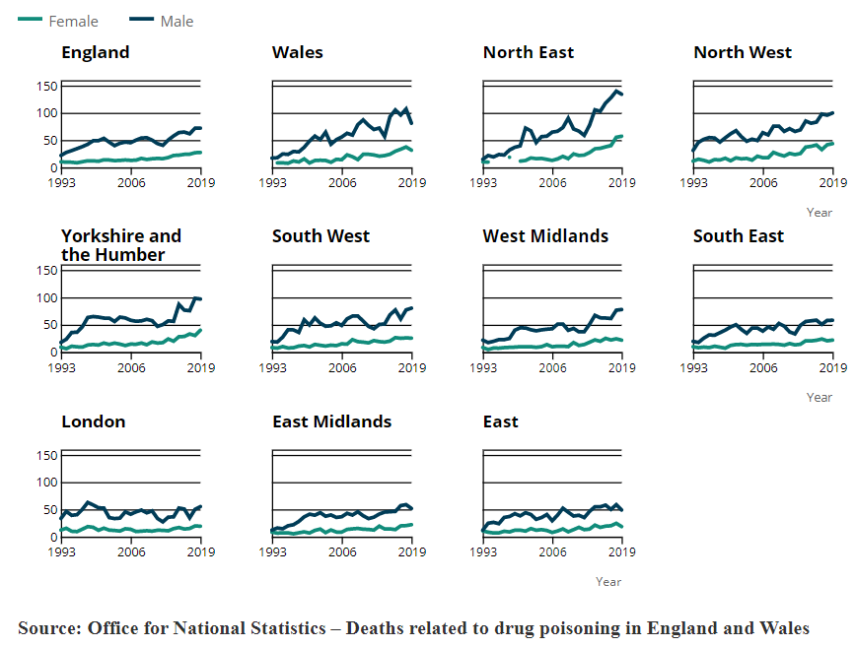
Drug misuse mortality varies by region
Rates of drug misuse death have a marked north-south divide
The North East has had the highest rate of any English region for the past seven consecutive years
The lowest rates in 2019 were in the East of England
But regional data masks significant local variation, eg Blackpool, Brighton

Slide 8
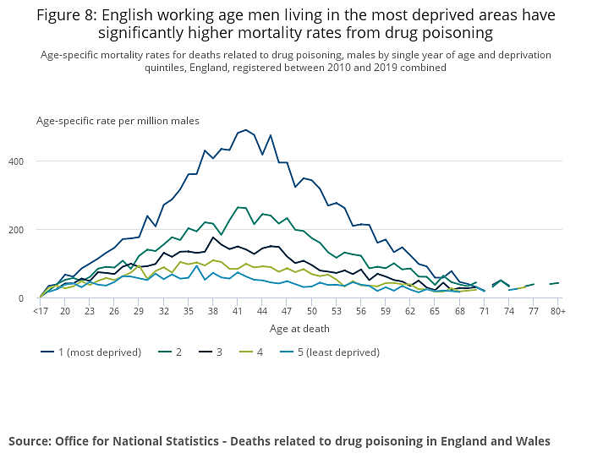
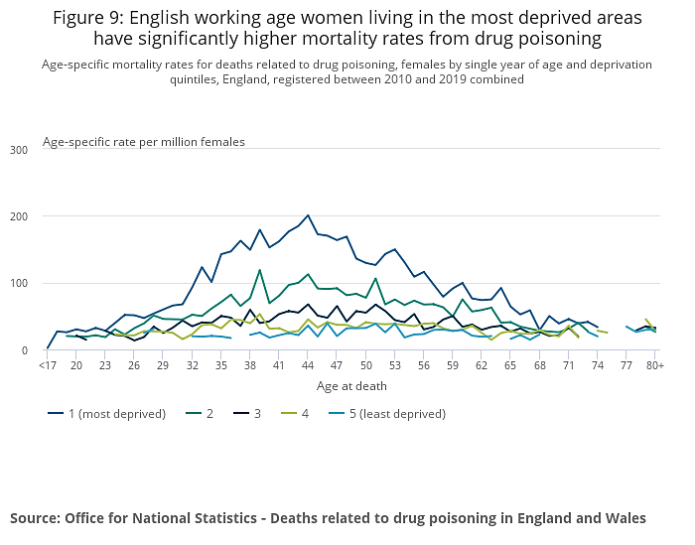
Men and women in deprived areas have higher rates
Text

Slide 9
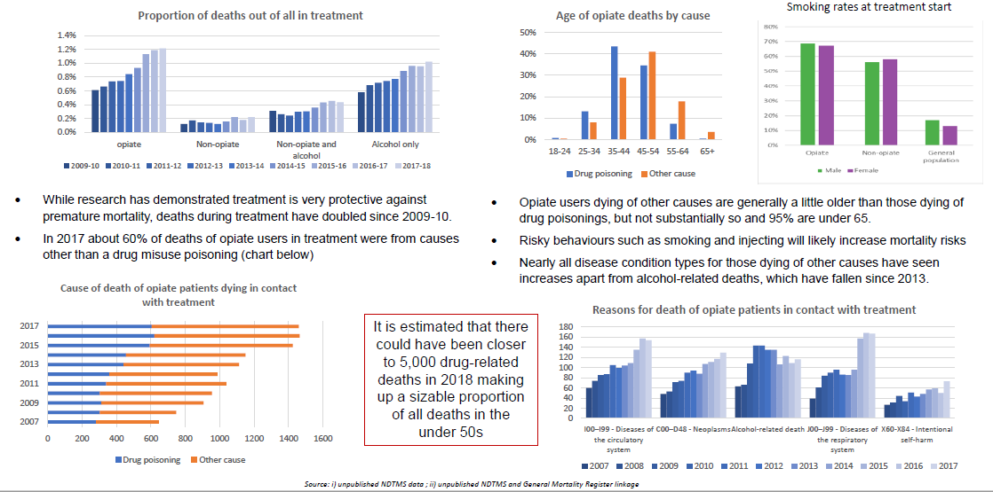
Drug misuse poisonings are just a subset of drug-related deaths

Slide 10
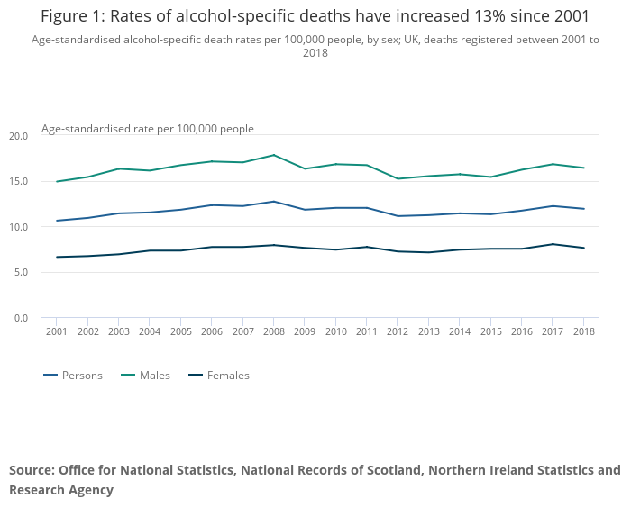
Alcohol-specific and alcohol-related deaths
Alcohol-specific deaths are where the cause of death could only be attributed to alcohol use, such as alcoholic liver disease
Rates have increased 13% since 2001
Alcohol-related deaths add in deaths by diseases where a proportion were caused by alcohol (such as cancers of the mouth, oesophagus and liver)

Slide 11
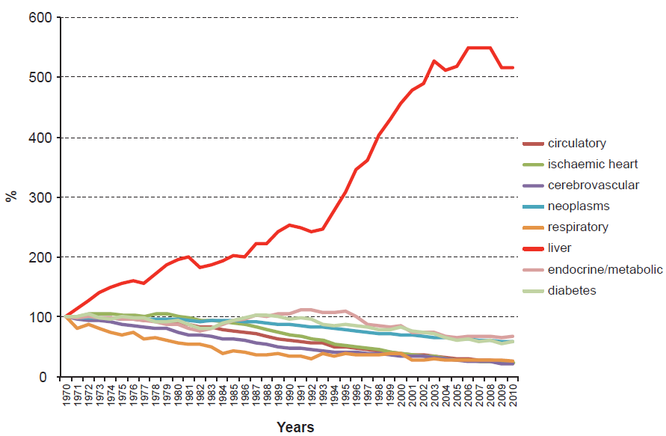
Liver disease has been an increasing contributor to mortality
Standardised UK mortality rate normalised to 100% in 1970
Much longer timescale on this (since 1970)
But, while other causes of mortality have fallen, liver disease has risen – majority is alcohol related

Slide 12
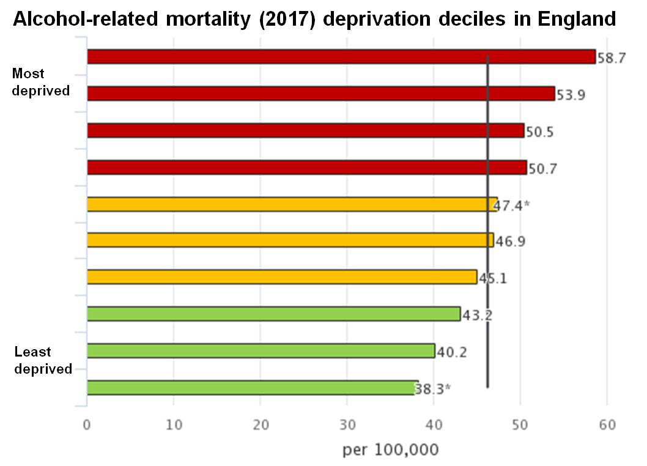
Alcohol mortality is similarly linked to deprivation
And to age: The average age at death of those dying from an alcohol-specific cause is 54.3 years, over 20 years before the average age of death

Slide 13
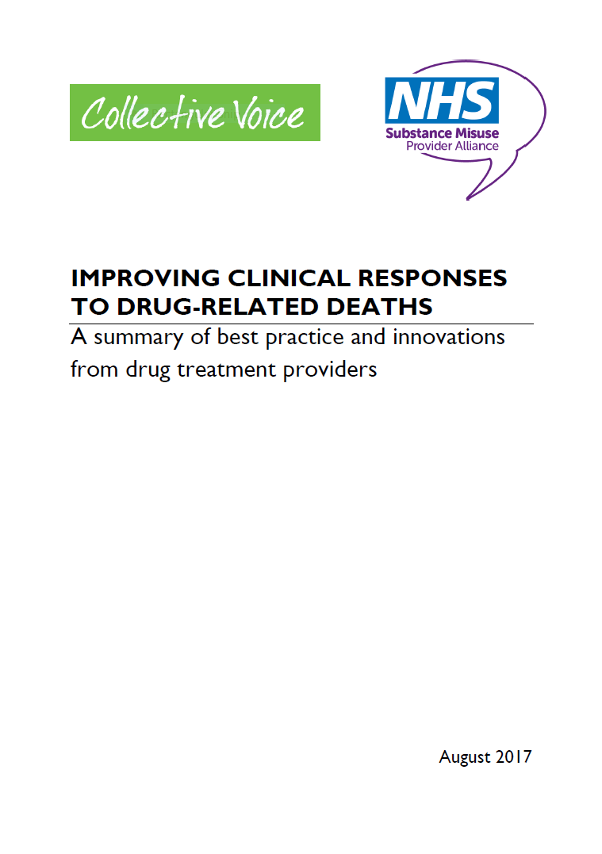
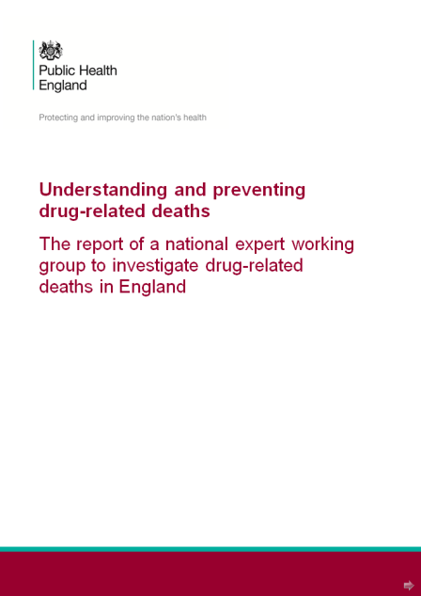
2016 inquiry findings on cause
Causes of the increase in DRDs are multiple and complex
Caused mainly by:
      increased availability of heroin (evidenced by association with purity as a proxy)
      an ageing heroin using cohort with health conditions making them susceptible to
      overdose
Other factors contribute smaller numbers but may become more significant:
      increasing suicides
      increasing deaths among women
      increasing deaths from drugs other than heroin
      more people dying with multiple drugs in their systems
      an increase in the prescription of certain medicines
      improved coroner identification and reporting of drug deaths
Until needs of the ageing cohort are met, and other factors above addressed, drug misuse deaths may continue to rise

Slide 14
2016 inquiry findings on factors
Evidence-based interventions already reduce the number of deaths
Correlation between health inequalities and drug-related deaths
People who move between services and have complex needs are at particular risk
PHE analysis did not establish a relationship between recovery and DRDs but poor practice at all levels could put people at greater risk
DRDs are not always sufficiently investigated at a local level
Entering and leaving drug treatment are times of heightened risk but receiving evidence based treatment offers significant protection

Slide 15
What’s changed since the inquiry?
Many things are just worse!
Ageing and ill-health still a factor
Even more dangerous drugs/combinations: psychoactive substances, street benzos, pregabalin, stimulants, fentanyls
Further falls in spending and provision, including NSP
Growing deprivation and divides (North-South, rich-poor, digital, food, healthcare, etc)
… and then we have a pandemic!

Slide 16
COVID-19 impact
In-treatment deaths appear to have increased: opiates and alcohol (provisional unpublished data – no visual)
Causes not yet known but COVID-19 deaths do not appear to account for the increase especially as it was sustained in months where COVID-related deaths were low
Methadone poisoning hospital admissions have increased substantially (provisional unpublished data – no visual)
Deaths from cirrhosis and other liver diseases in this period are higher than expected (next slide)

Slide 17
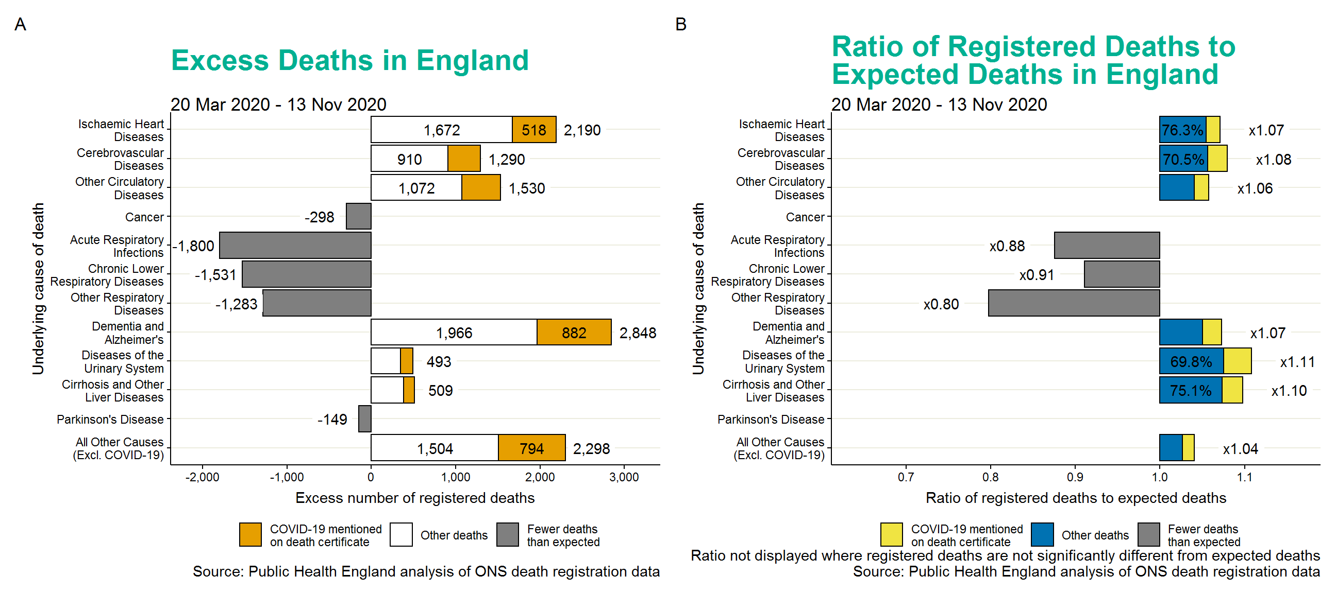
Liver disease is up

Slide 18
COVID-19 impact
In-treatment deaths appear to have increased: opiates and alcohol (provisional unpublished data – no visual)
Causes not yet known but COVID-19 deaths do not appear to account for the increase especially as it was sustained in months where COVID-related deaths were low
Methadone poisoning hospital admissions have increased substantially (provisional unpublished data – no visual)
Deaths from cirrhosis and other liver diseases in this period are higher than expected (next slide)
Not known for these latter two what proportion are in-treatment population
But questions about the impact of pandemic-driven changes in service provision on top of previous ‘shrinkage’: less face-to-face, less supervised consumption, less access to inpatient detox, less access to primary and inpatient healthcare
Drug market has fluctuated over time and between areas but supply mostly maintained – some (continued) increases in, eg street benzos
Also, forecast increases in unemployment, deprivation, debt, etc could fuel problems of drug and alcohol use

Slide 19
Hope for the future?
Dame Carol Black review part 2 recommendations will go to government this month – focus on the resourcing and structure of the commissioning system and how it needs to be fixed
Spending Review had nothing other than that the public health grant will ‘be maintained’ but promised to ‘set out further significant action … to improve the population’s health in coming months’
Rough sleepers programme includes funding for drug and alcohol treatment
Project ADDER in 4 areas in England with high DRDs (and crime) will test whole-system approaches that coordinate law enforcement, diversion, and enhanced treatment and recovery
Hepatitis C treatment and elimination – PHE/NHS commitment, NHSE money and programme
Depot buprenorphine: no diversion, less overdose, more recovery?

