Slide 1
The Blue Light project:
Safeguarding Vulnerable Dependent Drinkers
Collective Voice
December 2020

Slide 3
Domestic Homicide Reviews
Inquiries into Homicides by Mentally Ill People
Safeguarding Adult Reviews

Slide 4
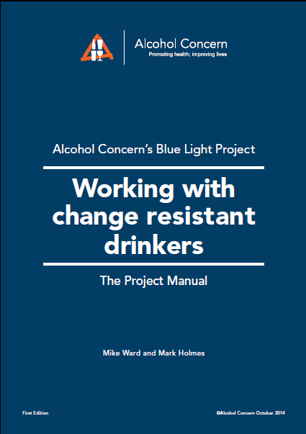

Slide 5
Angela Wrightson

Slide 6


Slide 7
“Alcoholic Angie”
In 3 years, over 1000 recorded direct contacts with mental health and alcohol services, ambulance, hospital.
472 reported incidents to the police.

Slide 9
Analysis of SARs published in 2017
41 reviews were found in total, 15 of which mention alcohol.
In 11 alcohol was a problem for the adult being safeguarded.
In every case, the serious incident was the death of the adult.

Slide 10
Alcohol-Related SARs
Professor Michael Preston-Shoot’s SAR analysis
57 cases (25%) where the principal focus was on a person with alcohol-related concerns
Correlations with self-neglect and/or homelessness
Examples of fire deaths involving alcohol abuse
Impact of loss and trauma
Additional 5 cases where someone in the person’s environment was alcohol-dependent
Highlights the importance of thinking family (domestic abuse, impact on children, understanding family and relational dynamics)
One case of a paid carer being alcohol-dependent

Slide 11
A motivation focused approach perpetuates the exclusion of the already most socially excluded clients.

Slide 12
At the end of the Blue Light pathway there are clients who are not changing and whose vulnerability means that they require some more structured framework to manage their behaviour.

Slide 13
Legal literacy
Professionals need a better understanding of the legal structures that can support and manage these very challenging clients.

Slide 14
Our national project to produce guidance and training on legal literacy with substance misusers.

Slide 15
Section 2
Legal powers

Slide 16
Powers
Containment Powers For Substance Misusers
The Care Act 2014 (England)
Mental Capacity Act 2005
(including DOLS and LPS)
Mental Health Act – 1983/2007

Slide 17
The Care Act 2014

Slide 18
Summary
The Care Act 2014 applies to people with alcohol problems.
Dependent drinkers with care and support needs have a right to assessment under the Act and, if they meet certain criteria, the right to a care package.
Dependent drinkers who are vulnerable, abused or self-neglecting require safeguarding by local authorities.
Self-neglect (and/or living with abuse and exploitation) should never be regarded as a “lifestyle choice”.

Slide 19
Mental Capacity Act 2005

Slide 20
Summary
The Mental Capacity Act 2005 applies to people with mental impairments due to the symptoms of alcohol or drug use
The compulsion associated with an addictive behaviour can be argued to over-ride someone’s understanding of information about the impact of their drinking. This can imply a lack of capacity.
Assessing capacity of dependent drinkers is very complex and should never be subject to quick and simplistic judgements.

Slide 21
Summary
Decisions may require multi-agency discussion and professional challenge.
Executive capacity should be included explicitly in assessments, linked to the person’s ability to use and weigh information.
It is important to consider what is in the client’s best interest.

Slide 22
The Mental Health Act 1983 and 2007 amendments

Slide 23
Summary
The Mental Health Act (2007) defines a mental disorder as “any disorder or disability of the mind”.
The Act’s definition of a mental disorder includes “Mental and behaviour disorders caused by psychoactive substances”.
It is possible to detain someone under the Act if they have disordered mental functioning due to their chronic drinking.

Slide 24
Summary
Such actions are likely to be rare and current practice does not make much use of this option. It would need to be a last resort and represent the least restrictive option now available to meet the person’s treatment needs.
Models of interventions in detained settings are available in other countries.

Slide 25
Summary
The challenge is that there needs to be a facility in which this treatment can occur.
This may need to be purchased from the private sector, if places cannot be made available in the local context.

Slide 26
And finally…
There will be more detailed training locally on this from January

Slide 27
`
mike.ward@alcoholchange.org.uk
www.alcoholchange.org.uk

