Slide 1


Health and Homelessness
Dee Menezes
Rob Aldridge, Dan Lewer, Alistair Story, Andrew Hayward, Michelle Cornes, Alexei Yavlinsky et al
7th December 2020
University College London

Slide 2
Inclusion Health…….what?
Inclusion health is a social justice movement to prevent and address the harms of extreme inequity
Inclusion health is a service, research, and policy agenda that aims to prevent and redress health and social inequities among the most vulnerable and excluded populations

Slide 3
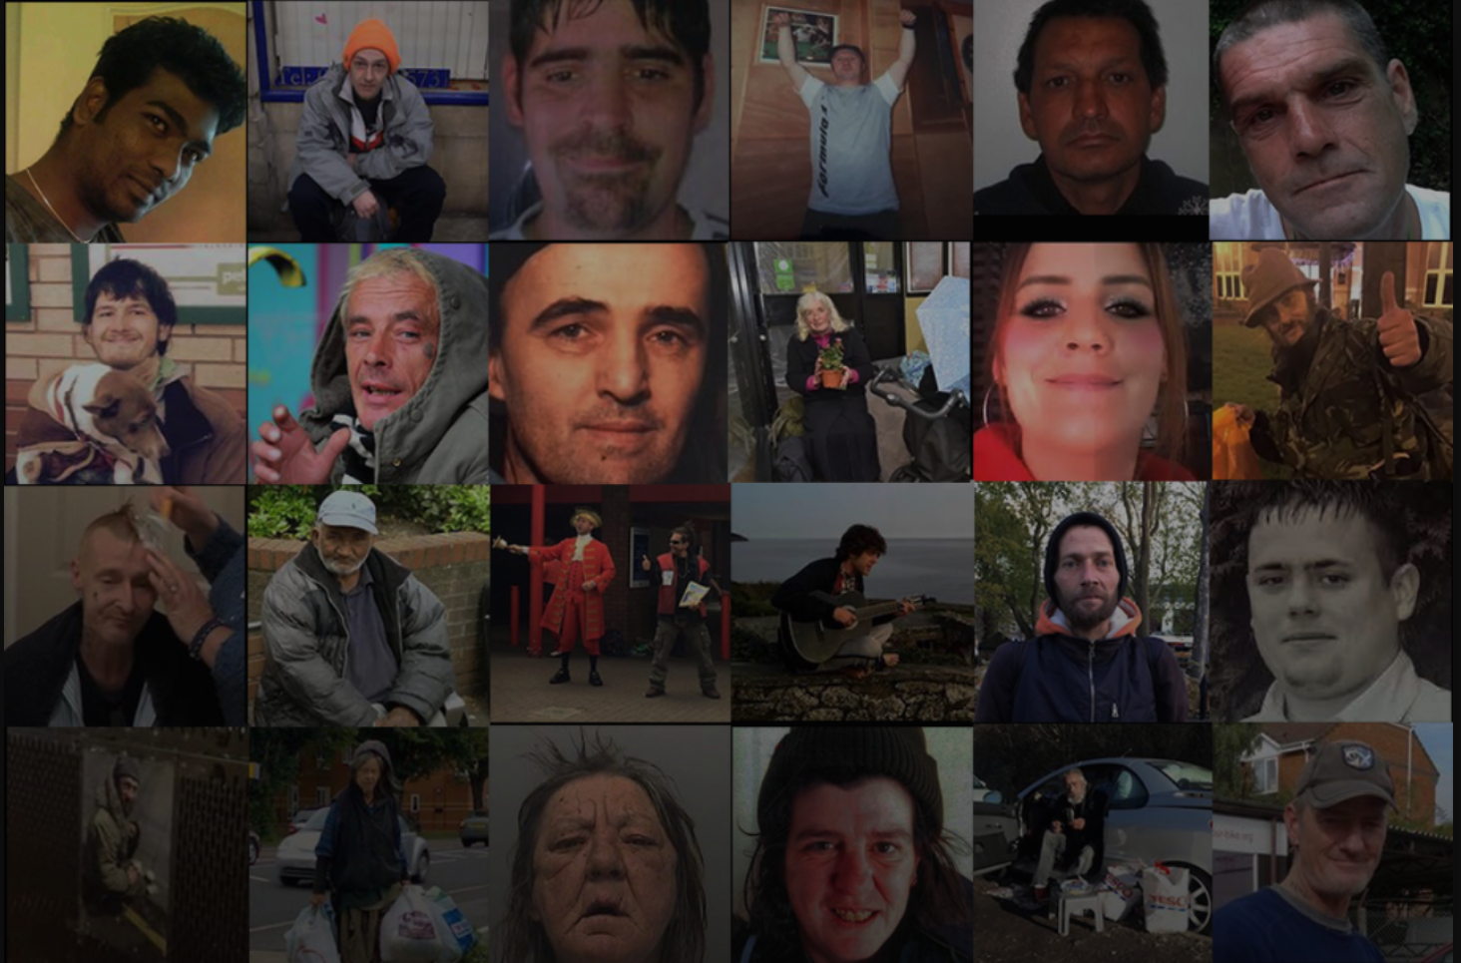
Causes of death among homeless patients in England
A population-based cross-sectional study of linked hospitalisation and mortality data
Rob Aldridge, Dee Menezes, Lewer D, Story A et al.
Wellcome Open Research 11 March 2019

Slide 6
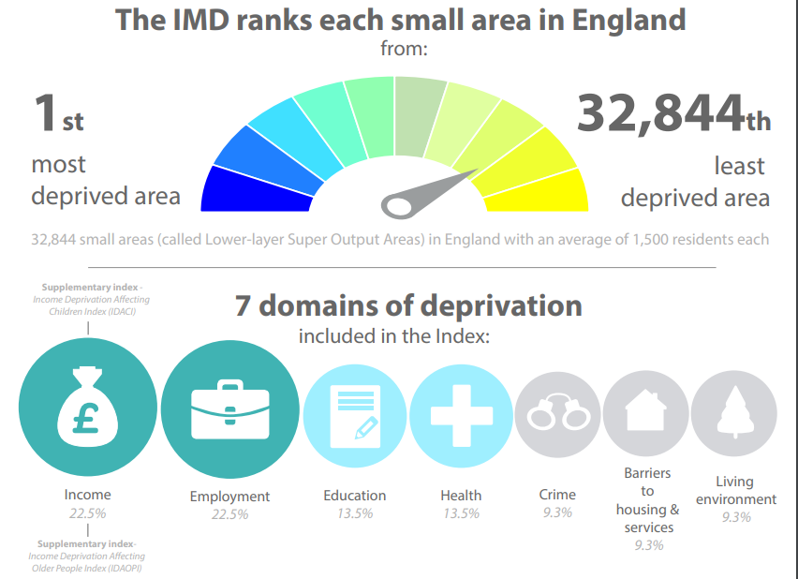
Since the 1970s, Department for Communities and Local Government and its predecessors have calculated local measures of deprivation in England.
Source: https://assets.publishing.service.gov.uk/government/uploads/system/uploads/attachment_data/file/464431/English_Index_of_Multiple_Deprivation_2015_-_Infographic.pdf

Slide 7
Since the 1970s, Department for Communities and Local Government and its predecessors have calculated local measures of deprivation in England.
Source: https://assets.publishing.service.gov.uk/government/uploads/system/uploads/attachment_data/file/464431/English_Index_of_Multiple_Deprivation_2015_-_Infographic.pdf

Slide 8
We collected data from specialist hospital-associated homeless service sites then linked it to National Hospital and death records
Homelessness Service
UCL
NHS Digital

Slide 9
We collected data from specialist hospital-associated homeless service sites then linked it to National Hospital and death records
Homelessness Service
UCL
De-identified:
- Hospital data
- Death Data
“Deprived housed” aka
IMD5
NHS Digital

Slide 10
Mortality outcomes
7.5% IMD5 group died
  median age of death 72
  23% of deaths from conditions amenable to healthcare
Definitions and ICD-10 code lists for avoidable, amenable and preventable mortality
http://discovery.ucl.ac.uk/10069223/

Slide 11
Mortality outcomes
7.5% IMD5 group died
  median age of death 72
  23% of deaths from conditions amenable to healthcare
15.5% homeless group died
  median age of death 52
  30.2% of deaths from conditions amenable to healthcare
Definitions and ICD-10 code lists for avoidable, amenable and preventable mortality
http://discovery.ucl.ac.uk/10069223/

Slide 12
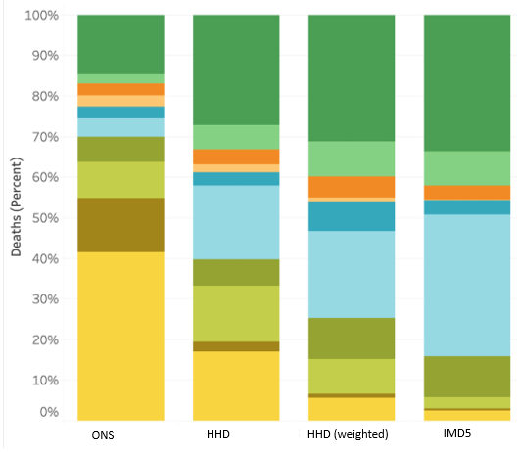
Underlying cause of death Homeless (weighted) vs IMD5
Source: Aldridge RW, Menezes D, Lewer D et al. Causes of death among homeless people: a population-based cross-sectional study of linked hospitalisation and mortality data in England. Wellcome Open Res 2019, 4:49

Slide 13
Underlying cause of death Homeless (weighted) vs IMD5
Source: Aldridge RW, Menezes D, Lewer D et al. Causes of death among homeless people: a population-based cross-sectional study of linked hospitalisation and mortality data in England. Wellcome Open Res 2019, 4:49

Slide 14
Underlying cause of death Homeless (weighted) vs IMD5
Source: Aldridge RW, Menezes D, Lewer D et al. Causes of death among homeless people: a population-based cross-sectional study of linked hospitalisation and mortality data in England. Wellcome Open Res 2019, 4:49

Slide 15
Underlying cause of death Homeless (weighted) vs IMD5
Source: Aldridge RW, Menezes D, Lewer D et al. Causes of death among homeless people: a population-based cross-sectional study of linked hospitalisation and mortality data in England. Wellcome Open Res 2019, 4:49

Slide 16
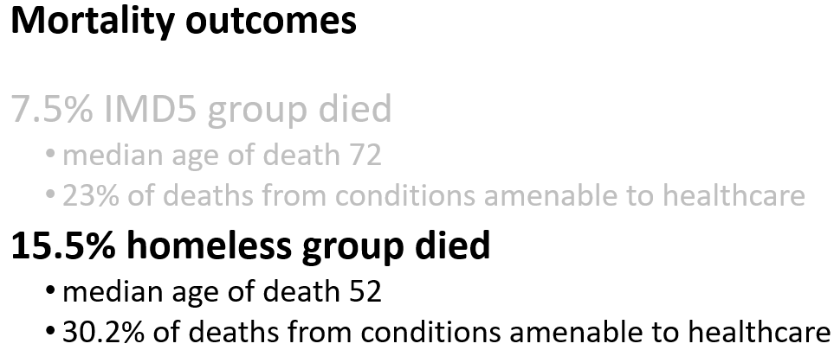
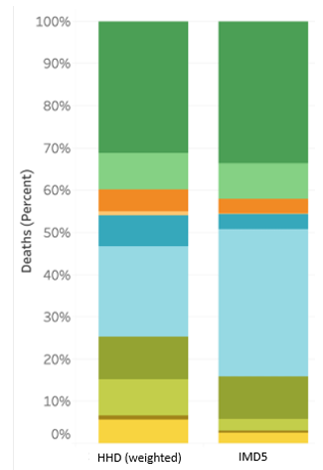
So what?
Source: Aldridge RW, Menezes D, Lewer D et al. Causes of death among homeless people: a population-based cross-sectional study of linked hospitalisation and mortality data in England. Wellcome Open Res 2019, 4:49

Slide 17
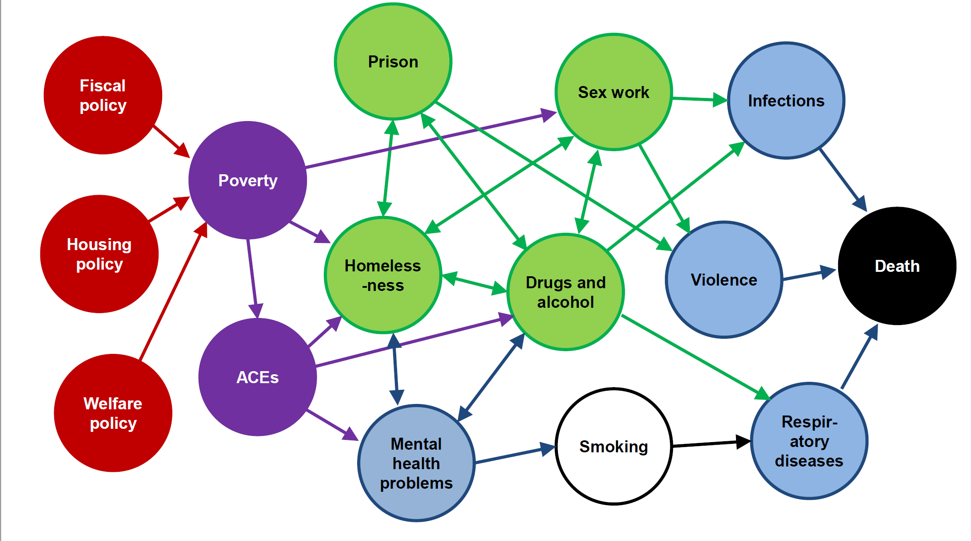

Slide 18
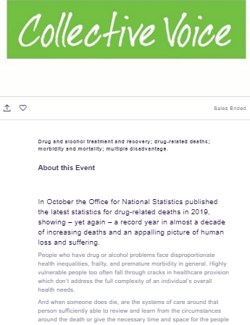
People who have drug or alcohol problems face disproportionate health inequalities, frailty, and premature morbidity in general.
Highly vulnerable people too often fall through cracks in healthcare provision which don’t address the full complexity of an individual’s overall health needs.

Slide 19
“It’s too
complicated...
…multifaceted
It was the previous Government’s fault.”
Beware of statements like this:
!

Slide 20

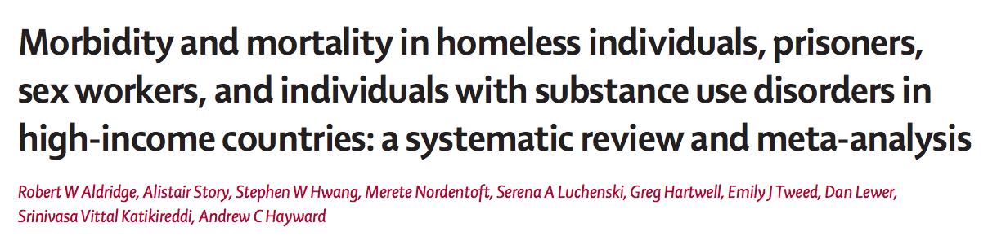
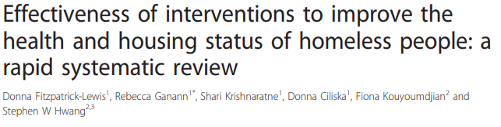
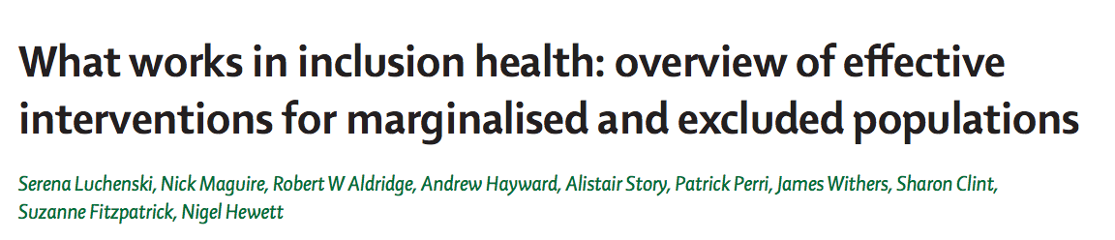

Slide 21
For homeless people with substance abuse issues or concurrent disorders, provision of housing was associated with decreased substance use, relapses from periods of substance abstinence, and health services utilization, and increased housing tenure.

Slide 22



Slide 23
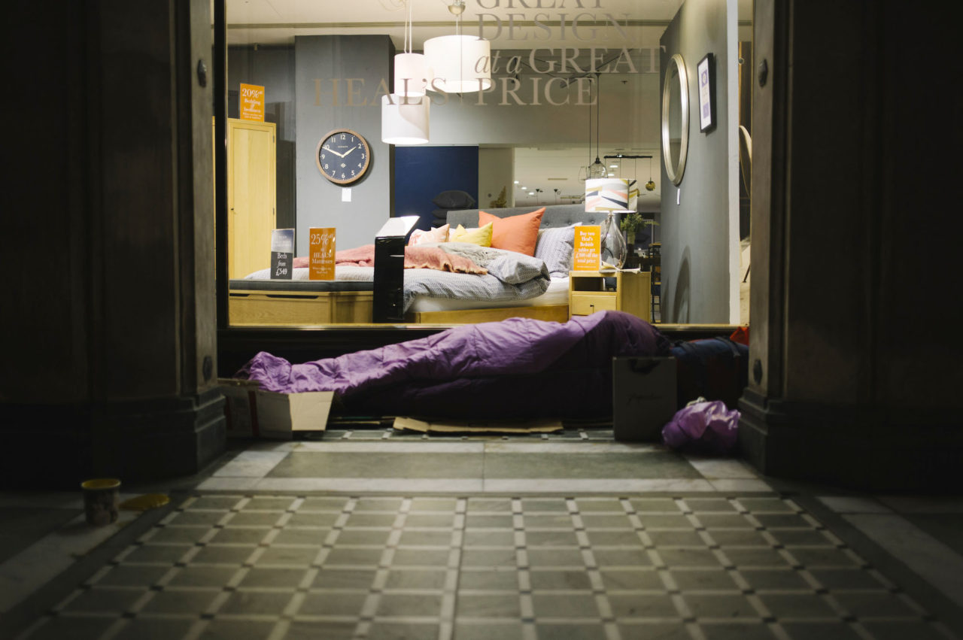
The challenge is to bring socially excluded populations in from the cold—literally and metaphorically—and to provide them with the opportunity to be part of a diverse and flourishing society. Michael Marmot
Dee Menezes
d.menezes@ucl.ac.uk
@Ruby_blue9

