Slide 1
Seizing the opportunities
Rosanna O’Connor,
Interim Director, Health Improvement
Public Health England
12th July 2021

Slide 2
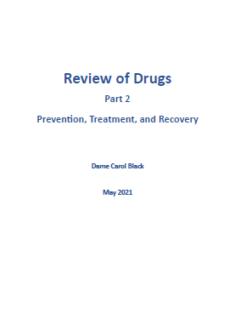
PHE welcomes the review
Thanks to……
  Dame Carol
  The PHE and DHSC team
  The field
The assessment of treatment an important platform for need change, but it is important to acknowledge:
  Continued hard work and commitment
  Pockets of good practice
  Success in maintaining services during the pandemic
  Rapid mobilisation is response to additional 80m treatment funding

Slide 3
This is a pivotal moment and opportunity
An initial government response is due soon, and more at the spending review planned for the autumn
  PHE stands ready to support the implementation of the recommendations, and they will be its priority
  This work will carry on in the new Office for Health Promotion
  Government engagement is high
PHE is supporting the establishment of the new Cross Government Drugs Unit
System reform is as important as additional resources- the two must work together

Slide 4
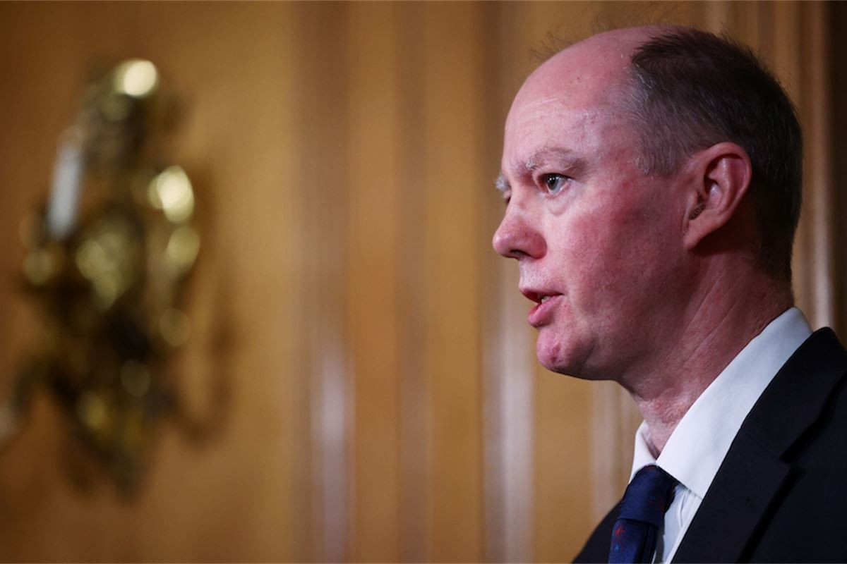
The Office for Health Promotion
All our drug and alcohol functions, both National and Regional will transfer into the Office for Health Promotion from October 2021
A Deputy Chief Medical Officer (DCMO) and a DHSC Director General will lead
Organisational structures are out to staff consultation but we anticipate our drug and alcohol work will be well placed in the new structure

Slide 5

Additional funding for drug treatment in 2021/22
£80 million to local authorities (LAs) to fund drug treatment in 2021/22
  Biggest increase in drug treatment funding for 15 years.
  Additional to the money LAs already spend from the public health grant
  Very significant in the context of a one year roll-over spending review
The majority of the funding is “Universal” which is being distributed to 142 LAs (every LA except those receiving “Accelerator” funding).
A further £10m was been allocated to joint commissioning of Inpatient detoxification (IPD).
  15 consortia covering almost every LA have been established and have agreed delivery plans which are now being mobilised
Timescales for the planning and mobilisation of both grants were demanding but the engagement and buy-in from local authorities and services has been impressive.
How universal funds are being spent nationally:
55%
of funding is focused on improving pathways and capacity for criminal justice clients
15%
is enhancing provision of naloxone outreach and NSP services
14%
is funding residential rehab and depot buprenorphine

Slide 6


Additional support
Distributed improvement support team
Support and challenge on the £80m uplift funding – (working closely with regional Alcohol and Drug leads) to ensure maximum impact from new funding – focus on North of England
Promoting learning and expertise – topic leadership around medically managed inpatient detox (IPD), criminal justice pathways, and partnership work)
Promoting Dame Carol Black’s recommendations – supporting implementation of recommendations from the review
Funding
PHE teams
Support
£80m + PHG
New distributed team
Universal grants
Inpatient detox consortia
PHE Centre teams
Mainstream funding
Treatment and recovery team
ADDER/ Accelerator sites

Slide 7



ADDER & Accelerators
Where?
What?
How?
  ADDER areas already underway
  8 Accelerator areas to be announced shortly
  Home Office, Department of Health and Social Care (DHSC) and PHE have secured £28m for Project ADDER until March 2023 and £10.1m for ADDER Accelerators in FY 21/22.
  Areas were selected based on evidence of drug harm from various data sources, including drug-related deaths and unmet need.
  The programme aims to reduce drug-related deaths, drug use and drug-related offending.
  A whole system approach led by police and health partners, delivering evidence-based enforcement, diversion, treatment and recovery interventions and joining up across enhanced employment, justice and housing programmes.
Middlesbrough
Blackpool
Norwich
Swansea
Hastings
Notes:
You’ll be aware of the pathfinding Project ADDER programme launched last year, led by Home Office, PHE and DHSC, to test a whole-system approach to drugs by bringing police and LAs together with just under £40m of additional funding going to selected local areas.
The areas were chosen because of high levels of local drug-related need as evidenced in drug-related death and offending rates.
The programme aims to support local areas to prevent future drug deaths and crime by strengthening pathways into drug treatment especially from the criminal justice system.
The 4 original Project ADDER areas in England & 1 in Wales launched last year and the 8 further Accelerator areas will be announced shortly.
Areas developed their plans by choosing which evidence-based interventions would meet identified local needs
The interventions they can choose to fund spans from enforcement, diversion and harm reduction through to treatment and recovery.
And included introducing new, or enhancing existing, diversionary interventions such as conditional cautions designed to divert people who use drugs away from the criminal justice system into drug treatment
As well as increasing outreach and treatment capacity and quality to meet the needs of those in and out of treatment through, for example:
enhanced outreach provision and harm reduction such as naloxone supply
piloting novel opioid substitution medication (Buvidal)
more residential detoxification and rehabilitation placements
more specialist psychological or physical health support to meet people’s mental and physical health needs
And supporting the development of peer-led interventions and recovery communities
With this additional funding and impetus to work collaboratively, local forces, LA commissioners, local treatment providers and key partner agencies are working together in these areas to deliver a whole system approach to drugs.
They’re being supported by:
the Home Office and national and regional PHE teams
senior cross government ‘sponsors’ (at Director General level) who are ‘buddying’ with local areas to support their partnership and get closer to the issues faced on the ground
and an expert panel working with local areas to problem solve any tricky aspects of delivery.
There are also regular partnership events focused on key topics to ensure that learning from Project ADDER is shared more widely.

Slide 8
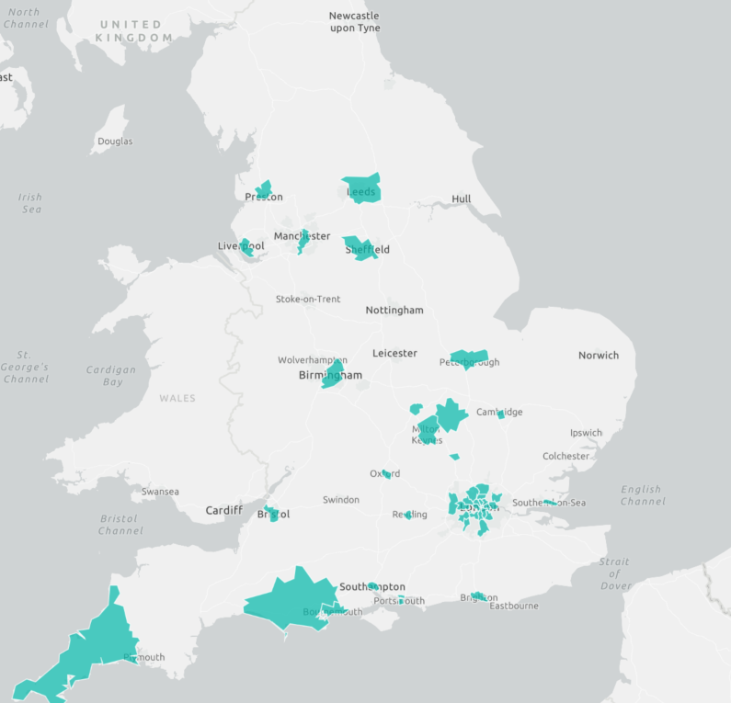
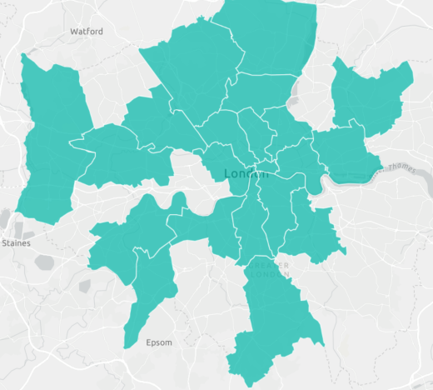
The Rough Sleeping Drug and Alcohol Grant
London
4 year funding of £262m announced at Budget in March 2020
to improve drug and alcohol treatment services for people who sleep rough or are at risk of sleeping rough
43 LAs were funded in 2020-21 with plans to extend to a further 20 LAs in 2021-22 (we will need to reconfirm the full 4 year pot at SR)
Eligible LAs are identified and invited to bid for funding
Supported by guidance, webinars and support from the national and regional PHE teams, and MHCLG Rough Sleeping Advisors
PHE and MHCLG are working together, including on evaluation
Thank you to all providers and commissioners who are making this happen.
In year 1, Dec 2020 – Apr 2021, the RSDATG funded 43 Local Authorities across England

Slide 9


Individual Placement and Support (IPS)
Building on the work of the IPS-AD trial
DWP investing a further £10.5m to expand access:
  11 ADDER/Accelerator sites receiving funding
  A further 28 areas will receive funding after competitive ‘expression of interest’ process
  6 of the original trail areas continuing to offer IPS
  Therefore 45 local authority areas, covering around 40% of those in structured treatment, will be providing IPS
helping thousands of people per year
adding to the evidence base
embedding IPS with new providers across England
Results of the IPS-AD trial will follow later this year/early next.
Notes:
If anyone asks about IPS-AD trial outcomes, all we can say is
We are looking at a range of outcomes to support analysis of effectiveness, cost effectiveness and cost-benefit (employment, changes to tax paid and benefits claimed, health status, use of health services, treatment outcomes, offending and mortality)
We’re gathering in the data at the moment and will start the process of analysis in coming weeks, with the aim of publishing late this year or (possibly) very early 2022
You can say that the post-trial, open-access IPS services that have been running in the 6 original areas have reported supporting about 30% of new IPS starters into work, with 177 first job starts (and a few dozen second/later job starts). Almost all of this period of operation has overlapped with the pandemic, so reaching 30% is particularly impressive in the circumstances

Slide 10



Improving criminal justice pathways into drug treatment
The cross government Crime and Justice Task Force has identified improving access and engagement in substance misuse service for offenders as a key area in the drive to reduce crime and re-offending.
Focus will be on:
increasing the uptake of treatment for individuals who are referred from prison to community-based treatment
increasing the number of community sentence treatment requirements particularly Drug Rehabilitation Requirements (DRRs)
More than 50% of the additional treatment funding made available for 2021/22 will be dedicated to improving criminal justice pathways into treatment.
In June 2021, the Probation Services in England and Wales were unified to deliver: enhanced support for prisoners through the gate; and more consistent management of offenders on community sentences.
Recent Police and Crime Commissioner elections resulted in significant changes, and we need engage new appointees in the agenda

Slide 11
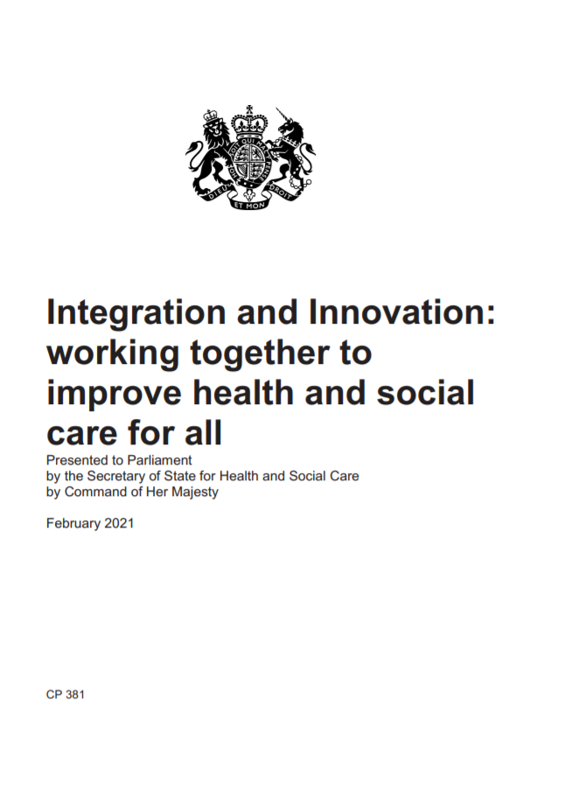
NHS reform
A Government white paper about NHS reform was published in February ‘Integration and innovation: working together to improve health and social care for all’
Two key proposals in the paper:
There will be a stronger ‘duty to collaborate’ between NHS/LA/3rd sector
Procurement will be less bureaucratic and collaboration rather than competition is encouraged – commissioning organisations will no longer be obliged to run competitive tenders, unless they are particularly needed. This will apply to LA commissioned health services
The negative effects of repetitive retendering cycles on drug and alcohol treatment services came up in the DCB review consultation. Dame Carol’s review recommends:
‘…that DHSC and the Office for Health Promotion review the effect of retendering on quality and cost-effectiveness of substance misuse treatment services.’

Slide 12
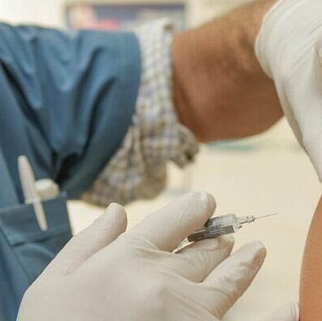
Integrated Care Systems
The pandemic led to much closer working relationships between local authorities and the NHS, including to provide support to vulnerable people – such as drug and alcohol users.
As we build back better, that partnership needs to become part of the operating model for ICSs – especially recognising the needs of those with multiple and complex needs.

Slide 13
We now have a real, and rare, opportunity
We must
Seize all the current opportunities
Build on the momentum generated by Dame Carol’s review
Unify as a field to serve the interests of those in need
Get our voices heard
Make it stick

Slide 14
Thank you

