Slide 1
Drugs and Alcohol and the Criminal Justice System
Meg Jones,
Director of New Business and Services

Slide 2
Introduction
Background
Head of Policy at West Midlands Police and Crime Commissioner, also led on Criminal Justice and Drugs Policy.
Cranstoun
Cranstoun’s vision is to be a world-class leader in rebuilding lives. We are working to identify, develop and deliver innovative, evidence-informed solutions that rebuild lives. Working across the areas of:
Substance use
Domestic Violence
Criminal Justice
Housing
Young People

Slide 3
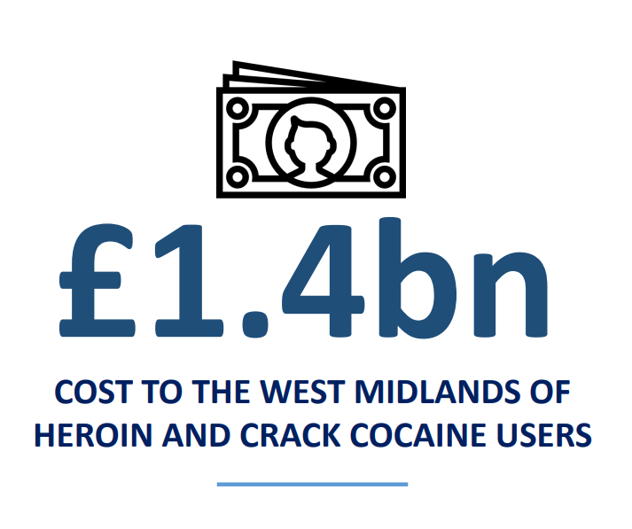
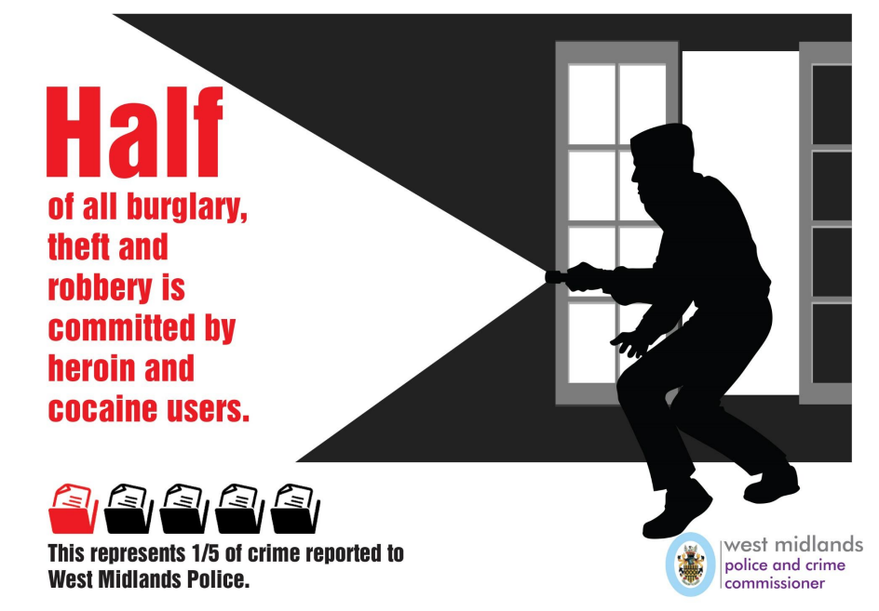
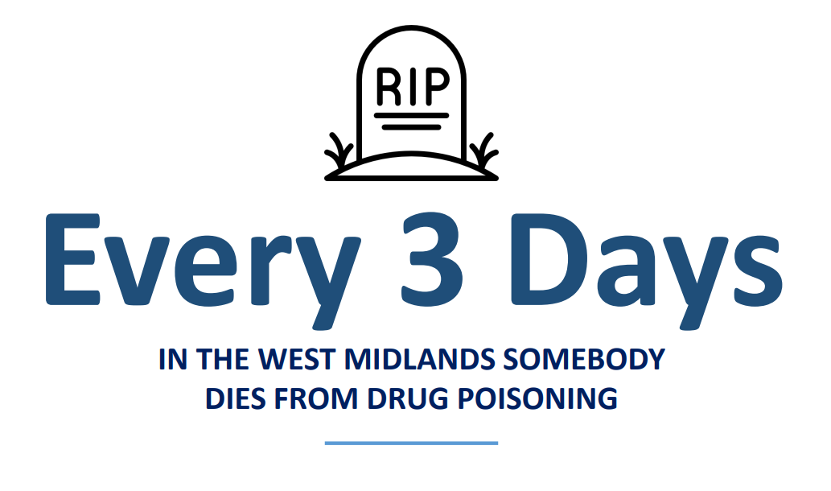
Case Study: West Midlands
In the West Midlands, the work led by the Police and Crime Commissioner established the scale of the problem caused by heroin and crack cocaine addiction

Slide 4
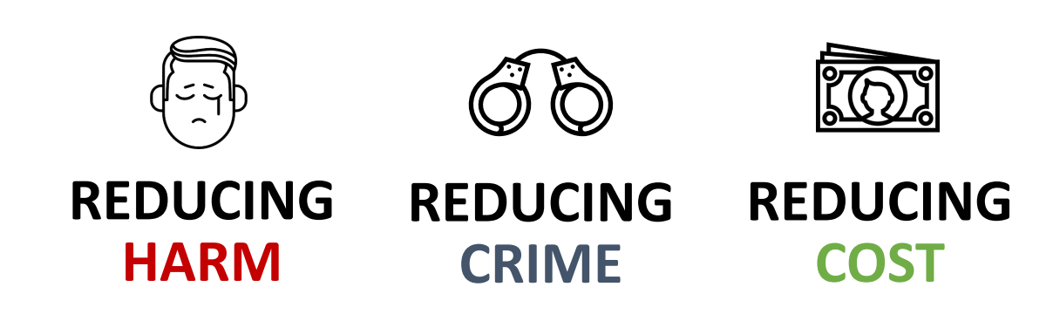
Case Study: West Midlands

Slide 5
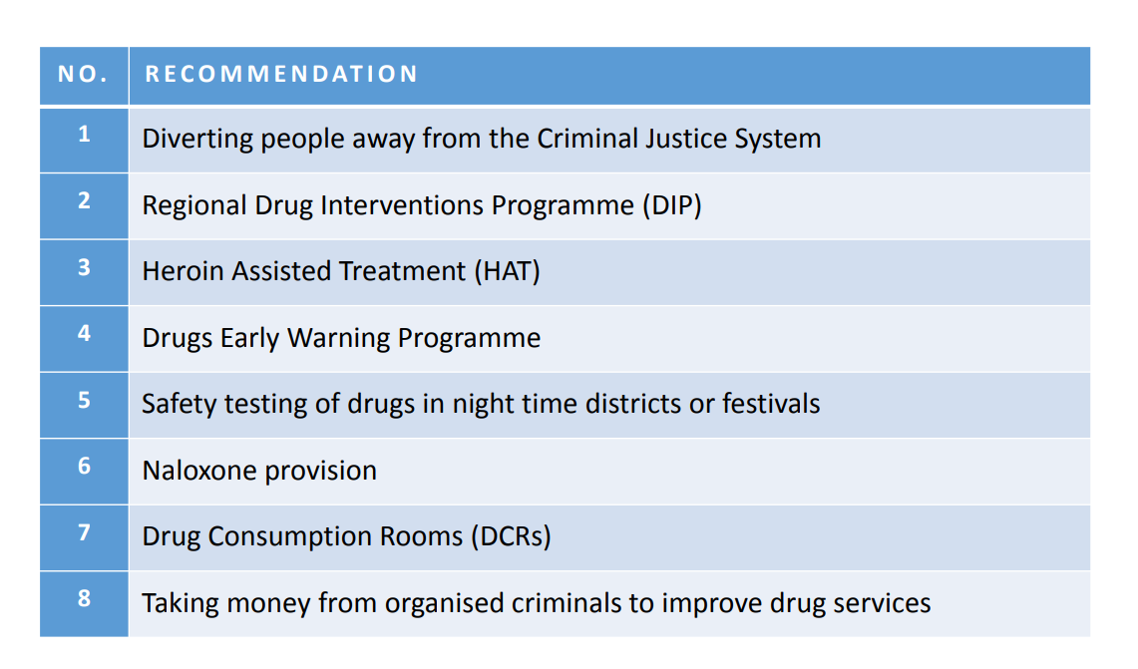
Case Study: West Midlands
Notes:
Naloxone – equipped officers in West Mids

Slide 6







The Cranstoun Approach – Criminal Justice
Pre-arrest
Point of Arrest
Custody
Courts
Prison Leavers
Future Innovation
DIVERT™
(Pre-arrest Drug Diversion)
Out of court Disposals
(Options to tackle drugs, alcohol and challenge domestic violence)
Cranstoun Arrest Referral Service
Prison Leavers Support Package
(Focus on support, peer mentorship, supporting a plan for returning to the community (ID, GP, Housing etc.)
Keeping People alive and well so recovery is always possible
(Linked to substance misuse: Heroin Assisted Treatment, Drug Consumption Rooms)
Assessments for Drugs and Alcohol through testing and voluntary engagement
Assessments for DRRs and ATRs
Working in partnership with Probation and Court colleagues. CSTR SPOCs and supporting ATR and DRRs granted at court

Slide 7
DIVERT™
Pre-arrest Drug Diversion Programme, works as a community resolution in the West Midlands.
Officer can deal with the drug possession on the street (reducing police demand) through an app on their mobile device
Engagement, education, harm reduction and support into other local services if needed.
Engagement rates of 88% since launch
Over 95% of individuals are caught in possession of cannabis
Over 90% treatment naïve
Early data on reoffending rates very positive
Supported individuals into further support such as housing, women's services, DV services and supported a small number who required further intervention into treatment
Numbers referred | 2230
Numbers Assessed | 1612
Numbers attending group | 1357
DIVERT: From start of contract (Oct 20)

Slide 8
Cranstoun Arrest Referral Service (CARS)
Learning from the old Drugs Intervention Programme (good and bad)
Postcode lottery across force areas of provision / super blocks
CARS commissioned to go live 1st January 2020 consistently working across West Mids Police force area and with Probation colleagues in court
Last year (2020), over 1000 individuals (not previously engaged) were supported into local drug and alcohol treatment provision.
Using the CARS and Community Team data measuring referrals entering effective treatment we can estimate a cost avoidance impact in excess of £8million.
CARS: From start of contract (Jan 20)
Since Jan 2020:
DRR Granted - 307 ATR Granted - 201
Number of Contacts (all levels of contact) | 18523 (14518 were contact only)
Number Of Assessments | 3998 | Most of these are voluntary assessments
Number of Referrals | 2218

Slide 9
Our Learning: Cranstoun Criminal Justice Services in the West Midlands
Increased use of DRRs and ATRs in the West Midlands through consistent WMP wide service
Increased and supported referrals into local drug treatment (Previous unmet need)
Benefits of voluntary assessments
Diversion as early as possible (DIVERT™, reduces impact on CJS) as well as OOCD. DIVERT now operates across the West Midlands, West Mercia and areas of Thames Valley
Joint working with PCC, Probation, Local Authorities and third sector. Joint commissioning and pooling of funding
We have a failing national approach to drugs policy. Government support for HAT, DCRs, greater consistency of diversion opportunities

