Slide 1
Integrated care systems
Anna Charles
Senior adviser to the chief executive, The King’s Fund

Slide 2
Integrated care systems
Integrated care systems (ICSs) are partnerships that bring together NHS organisations, local authorities and others to take collective responsibility for planning services, improving health and reducing inequalities across geographical areas.
Commissioners / planners
NHS commissioners
Local authorities
NHS providers
Acute trusts
Mental health trusts
Other providers
GPs and community pharmacies
Voluntary sector and social enterprises
Community trusts
Ambulance trust
Social care providers
Collectively understanding needs & setting priorities
Pooling resources & aligning strategies
Supporting changes to services and to infrastructure e.g. IT
Managing the performance of the system

Slide 3
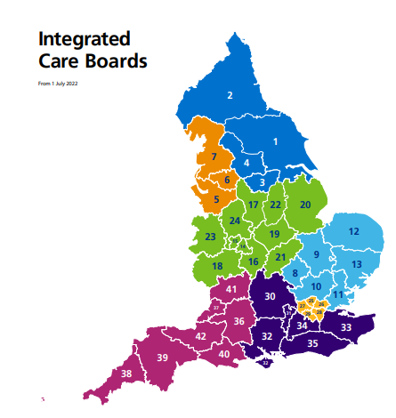
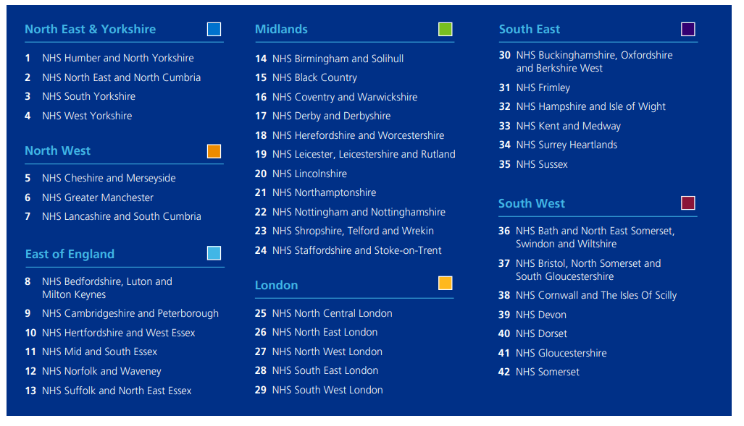
Integrated care systems in England

Slide 4
What is the point of ICSs?
Joining up services to deliver better integrated care
Improving population health and tackling inequalities
As part of a broader strategic shift:
  But what they were set up for does not always match what they’re now being asked to focus on…
Moving from… | Towards…
Focus on organisations | Focus on populations and places
Competition and market mechanisms | Integration and partnership
Transactional relationship between commissioners and providers | Partnership relationship between commissioners and providers

Slide 5
What do ICSs look like?
There are some common features to the basic governance model
  Dual structure comprising an integrated care board (ICB) and an integrated care partnership (ICP)
Variation is significant: size, complexity, local challenges, involvement, ways of working, maturity
ICSs are still evolving, this is a work in progress
It’s not all about ICSs – much of the ‘work’ of integration will happen more locally, and more local partnerships are forming within ICSs

Slide 6
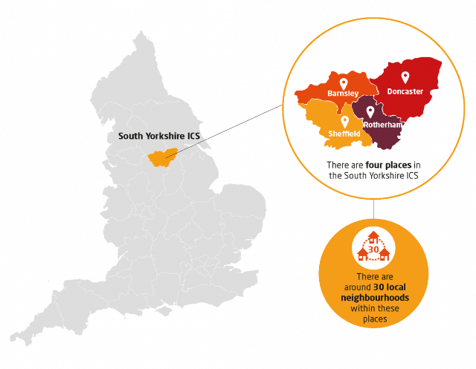
Systems places and neighbourhoods
Tier | Construct | Approx population | Examples of potential focus
System | ICS | 1-3 million | Setting strategy; managing some resources and performance; supporting cross-cutting programmes eg digital infrastructure and estates; working with ‘provider collaboratives’
Place | Place-based partnership | 250,000-500,000 | Driving service change; joint working with local government; supporting primary care networks; building relationships with communities; developing the workforce
Locality / neighbourhood | Primary care network | 30,000-50,000 | Bolstering primary care services; building multi-disciplinary teams that bring different professionals together; preventive interventions for at-risk groups
The role of ‘provider collaboratives’ will also be increasingly important.

Slide 7
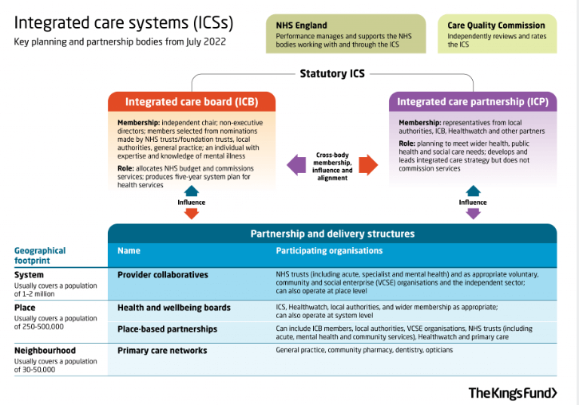
ICSs: understanding the detail
More detail at:
www.kingsfund.org.uk/audio-video/integrated-care-systems-health-and-care-act
www.kingsfund.org.uk/publications/integrated-care-systems-explained

Slide 8
Risks and opportunities
ICSs have been “born into a storm”: performance, workforce, estates, economy, political instability
Risk of a short-term focus on immediate operational priorities at the expense of longer term objectives, and of unrealistic expectations/ asks
Some major barriers to integration remain; ICSs only take us so far on the path to integration e.g. structural differences in NHS/ LA funding remain
But there is strong support for and commitment to the reforms and objectives around tackling inequalities and improving population health remain front and centre locally, even if national attention is elsewhere
key opportunities include: closer connections between the NHS and local government and VCS built on an ethos of equal partnership; a renewed strategic focus on action to drive improvements in population health and inequalities; new ways of working with communities and citizens

Slide 9
Thank you

