Slide 1


Me!
Independent management consultant
Was ‘in’ drug and alcohol treatment sector for 20 years
Front line, management, policy, training,15 years an exec
Trying to leave but keep getting drawn back in!
Integrated health and social care for excluded groups my passion
Notes:
Today is to align our thinking and is very much a starting point to how we proceed in this new landscape.
Kevin Crowley Kevin has 20 years’ experience in senior leadership and social change – most recently, as executive director of quality, governance and innovation at CGL. He has set up and led programmes as diverse as organisational restructures, digital strategy, advanced analytics and quality improvement cycles. His academic background is in law and policy and he has worked in substance misuse and social care since 1997, including a period as an advisor at the Home Office and leading the Drugs Intervention Programme for the National Treatment Agency. He has held a number of C-suite responsibilities including CQC Nominated Individual, Senior Information Risk Owner, CIO and Caldicott Guardian. He has board level experience as chair of a housing association and a number of social enterprises as well as Associate Non-Executive Director at a foundation trust.

Slide 2
Why we’re here
Making space to explore what the D&A sector should be doing in the integrated care space
Looking to the Future – exploring what this means for the sector and our future strategic priorities
Understanding our readiness for both
Notes:
Today is to align our thinking and is very much a starting point to how we proceed in this new landscape.
Kevin Crowley Kevin has 20 years’ experience in senior leadership and social change – most recently, as executive director of quality, governance and innovation at CGL. He has set up and led programmes as diverse as organisational restructures, digital strategy, advanced analytics and quality improvement cycles. His academic background is in law and policy and he has worked in substance misuse and social care since 1997, including a period as an advisor at the Home Office and leading the Drugs Intervention Programme for the National Treatment Agency. He has held a number of C-suite responsibilities including CQC Nominated Individual, Senior Information Risk Owner, CIO and Caldicott Guardian. He has board level experience as chair of a housing association and a number of social enterprises as well as Associate Non-Executive Director at a foundation trust.

Slide 3
The problem(s) as I see it
Health of ‘our’ service users is poor and getting worse
Early onset of later life illnesses and early death
Lack of early access to mainstream health is killing people (a rights issue)
Service (dis)integration
Not enough resource to solve the problems alone
Alcohol, alcohol, alcohol
Notes:
Today is to align our thinking and is very much a starting point to how we proceed in this new landscape.
Kevin Crowley Kevin has 20 years’ experience in senior leadership and social change – most recently, as executive director of quality, governance and innovation at CGL. He has set up and led programmes as diverse as organisational restructures, digital strategy, advanced analytics and quality improvement cycles. His academic background is in law and policy and he has worked in substance misuse and social care since 1997, including a period as an advisor at the Home Office and leading the Drugs Intervention Programme for the National Treatment Agency. He has held a number of C-suite responsibilities including CQC Nominated Individual, Senior Information Risk Owner, CIO and Caldicott Guardian. He has board level experience as chair of a housing association and a number of social enterprises as well as Associate Non-Executive Director at a foundation trust.

Slide 4
The root of the problem(s)
Mental models of commissioners, services and service users?
Deprivation, ACES, Trauma, Stigma?
Isolated and atomised commissioning
Competition and cuts
15 years of siloed contracting
(dis)integration of services
Have we been “parked” by the rest of mainstream H&SC?
Notes:
Today is to align our thinking and is very much a starting point to how we proceed in this new landscape.
Kevin Crowley Kevin has 20 years’ experience in senior leadership and social change – most recently, as executive director of quality, governance and innovation at CGL. He has set up and led programmes as diverse as organisational restructures, digital strategy, advanced analytics and quality improvement cycles. His academic background is in law and policy and he has worked in substance misuse and social care since 1997, including a period as an advisor at the Home Office and leading the Drugs Intervention Programme for the National Treatment Agency. He has held a number of C-suite responsibilities including CQC Nominated Individual, Senior Information Risk Owner, CIO and Caldicott Guardian. He has board level experience as chair of a housing association and a number of social enterprises as well as Associate Non-Executive Director at a foundation trust.

Slide 5
ICS
What are the policy drivers (hidden drivers)?
Integration of services
Population level view of healthcare
Determinants and prevention of healthcare issues
Collaboration not competition to drive strategy
(political control post pandemic)
(conversely plausible deniability!)
(Efficiency)
Notes:
Look behind the noise and find signals of what is really going on
Strategic and organisational alignment

Slide 6
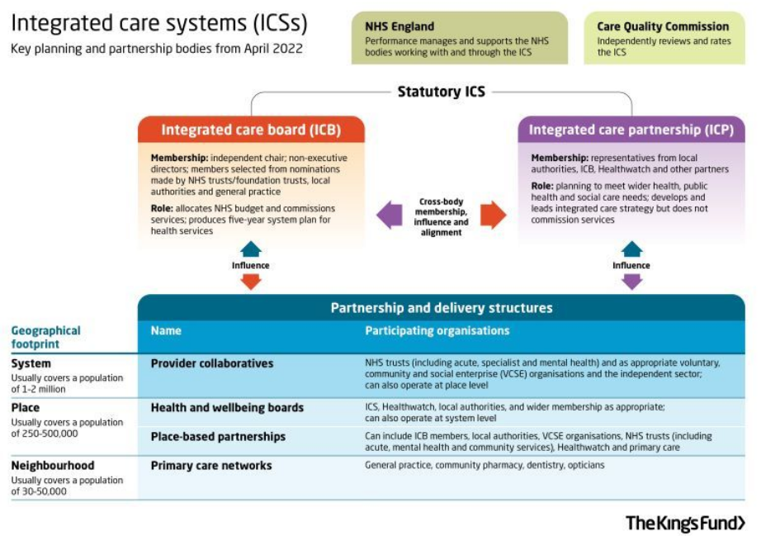
Notes:
ICB is where the money they power and the glory live – everything else is advisory.

Slide 7
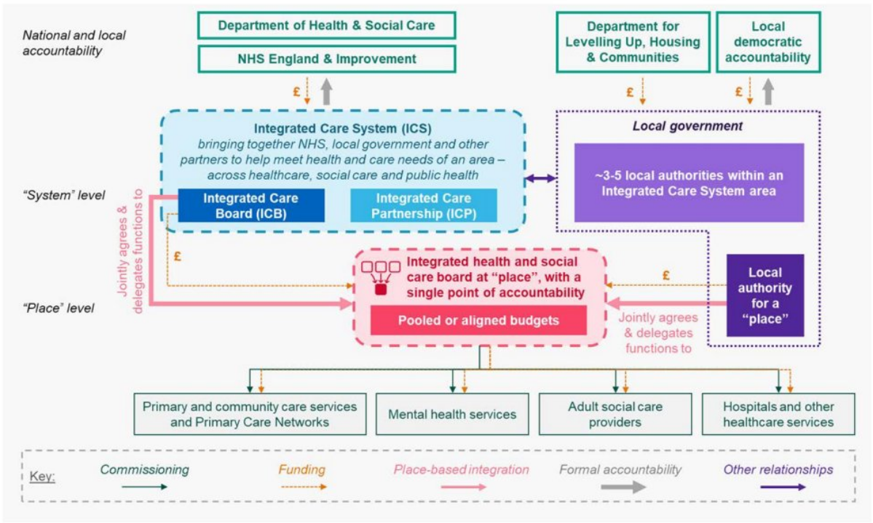

Slide 8
ICS
So what?
70% of healthcare commissioning has changed
Mental Health and adjacent sectors have moved
Prison health (including SM) is moving?
Provider collaboratives are up and developing
Provider Selection Regime will bring SM in ICB scope
NHS FTs as de facto commissioners
More importantly… integration opportunities.
Notes:
Look behind the noise and find signals of what is really going on
Strategic and organisational alignment

Slide 9
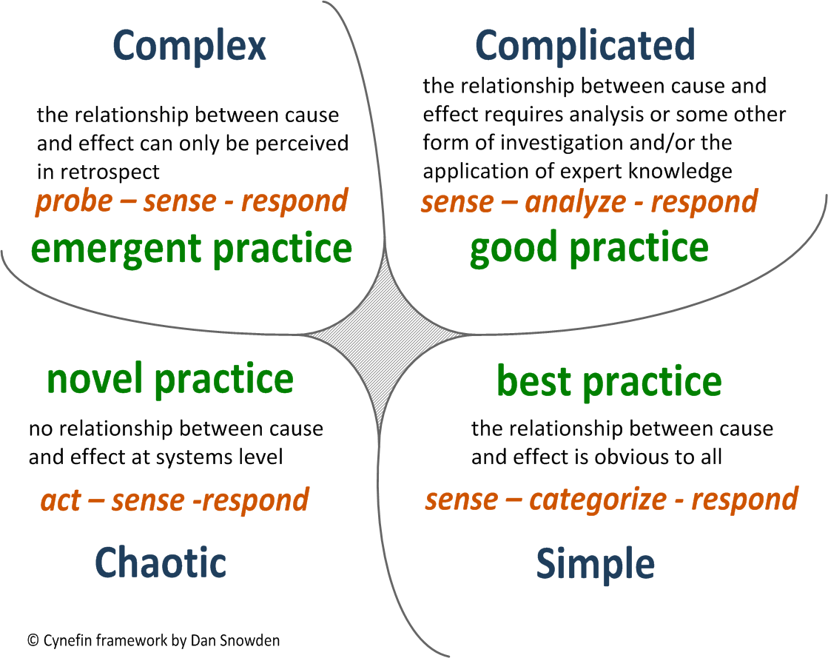
ICS WTF?
Notes:
Not quite at the Chaotic quadrant but certainly complex!

Slide 10
It’s complex, so what should we do?
Probe – sense - respond
Need to geo locate.
What is your place in the new systems?
What do you want to do within integrated care systems?
What value can the sector bring that others are unable to?
Notes:
I think we are creating the conditions for joining mainstream health and social care
Making the business case for our service users
Making our services the front door to H&SC
Making our local management the systems analysers
Taking a wider view on determinants of health and the health of our SUs
New world is relational not transactional
Relationships, relationships, relationships

Slide 11
It’s complex, so what should we do?
Probe – sense - respond
We want to create the conditions for integrating with health and social care
Making our services the front door to H&SC
Making our local management the systems analysers
Taking a wider view on determinants of health and the health of our SUs
Making the business case for our service users to mainstream health
New world is relational not transactional
Relationships, relationships, relationships
Notes:
I think we are creating the conditions for joining mainstream health and social care
Making the business case for our service users
Making our services the front door to H&SC
Making our local management the systems analysers
Taking a wider view on determinants of health and the health of our SUs
New world is relational not transactional
Relationships, relationships, relationships

Slide 12
Perceptual or actual barriers?
The mental models of healthcare are strong
We are different to other sectors
We can look… odd
VCSE governance is good but sometimes looks… odd
Information governance
Identity and “brand” issues
Tension between health and social care
Between social action and NHS delivery vehicles

Slide 13
Starter SWOT
Strengths Footprint in multiple systems Good commissioning relationships Outreach & engagement models Clinical workforce & strong clinical brand HSCN and SCR access – this is big NHS TUPE’d staff with NHS T&C’s and Pensios Integration expertise (IAPT/COPD/Clinical delivery) ‘NHS’ recognised Governance (Clinical structure and governance, CQC registered, HSCN governance, NHSDPT, Cyber Essentials) Already embedded in H&SC systems Culture of entrepreneurialism Local distributed leadership Case management flexibility Dual diagnosis experience Housing experience Financial position to support investment Experience of critical LA systems – safeguarding, SCRs, DHRs | Weaknesses Knowledge gap – unknown unknowns Gaps in sector understanding of Service User Healthcare needs Multiple case management systems with no roadmap to interoperability Absence of integration strategy Comparatively Isolated Third sector ‘status’ undervalued Short term contracts for long term thinking Cultural identity of SM services vs clinical Staffing vs national skills shortage in NHS Information sharing GDPR consent issue Other governance gaps as per light touch governance review
Opportunities A genuinely growing market Broader contracts to make a difference Diversification into aligned delivery (Dual diagnosis, primary care, mental health, homelessness etc etc) A chance to get ‘upstream’ into prevention Embedding SM in supportive systems Dismantling third sector stereotypes Addressing stigma Addressing health inequalities Funding technology platforms Longer term funding commitments | Threats Procurement rules changing Substance Misuse market vulnerability to keep/swap/compete methodology Nimble new ‘broad spectrum’ providers overtake you Local authorities new spending squeeze Integration in fact meaning NHS delivery New commissioning arrangements A return of the foundation trusts Governance gaps become problematic Interoperability becomes mandatory
Notes:
Our real strengths are:
Nimble
Social Justice
Service User Involvement
Effective
Outcomes
Efficient at using resources
Value for money
We deal with risk and complexity in a comparatively effortless way
We are innovative
We are commissionable

Slide 14
Leverage points?
Probe – sense - respond
Hard Leverage Points
LA JSNAs
Population Health Management/Improvement
Combatting Drugs Partnerships
ICP/B place based structures
ICP/B Drug and Alcohol responsibilities
Commissioning and other consultations
Central govt OHID/DHSC/NHSE&I
Soft Leverage Points
Active partnership work
Relationships, relationships, relationships
Notes:
I think we are creating the conditions for joining mainstream health and social care
Making the business case for our service users
Making our services the front door to H&SC
Making our local management the systems analysers
Taking a wider view on determinants of health and the health of our SUs
New world is relational not transactional
Relationships, relationships, relationships

Slide 15
Norfolk!
Probe – sense - respond
ICB Board Members - Norfolk and Waveney ICS (improvinglivesnw.org.uk)
New Chair Appointed to Norfolk & Waveney VCSE Health and Social Care Assembly - The Assembly (vcseassemblynandw.org.uk)
*Norfolk and Waveney Clinical Strategy 2022-2027[11083].pdf
Alcohol, mental health and social exclusion a strategic priority
Notes:
I think we are creating the conditions for joining mainstream health and social care
Making the business case for our service users
Making our services the front door to H&SC
Making our local management the systems analysers
Taking a wider view on determinants of health and the health of our SUs
New world is relational not transactional
Relationships, relationships, relationships

Slide 16
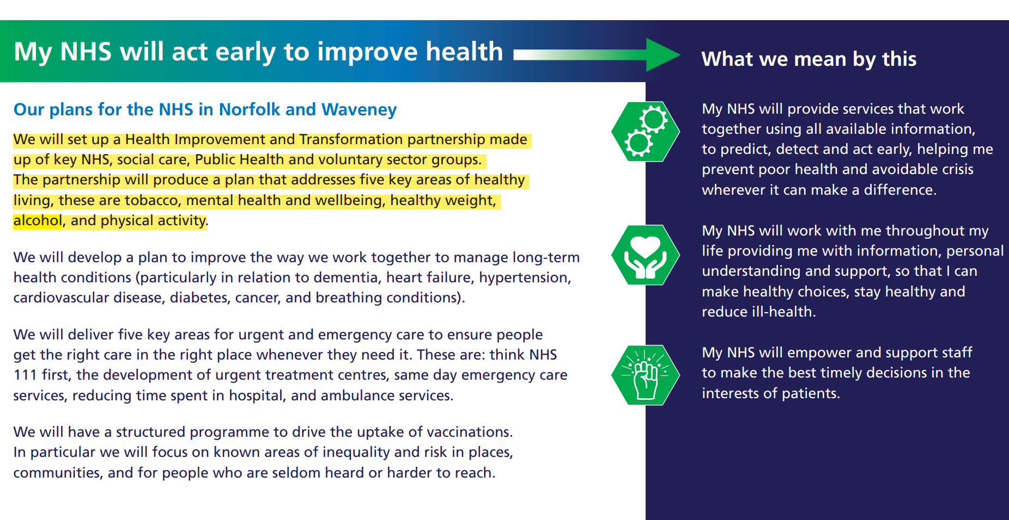
Norfolk!
Probe – sense - respond
ICB Board Members - Norfolk and Waveney ICS (improvinglivesnw.org.uk)
Notes:
I think we are creating the conditions for joining mainstream health and social care
Making the business case for our service users
Making our services the front door to H&SC
Making our local management the systems analysers
Taking a wider view on determinants of health and the health of our SUs
New world is relational not transactional
Relationships, relationships, relationships

Slide 17
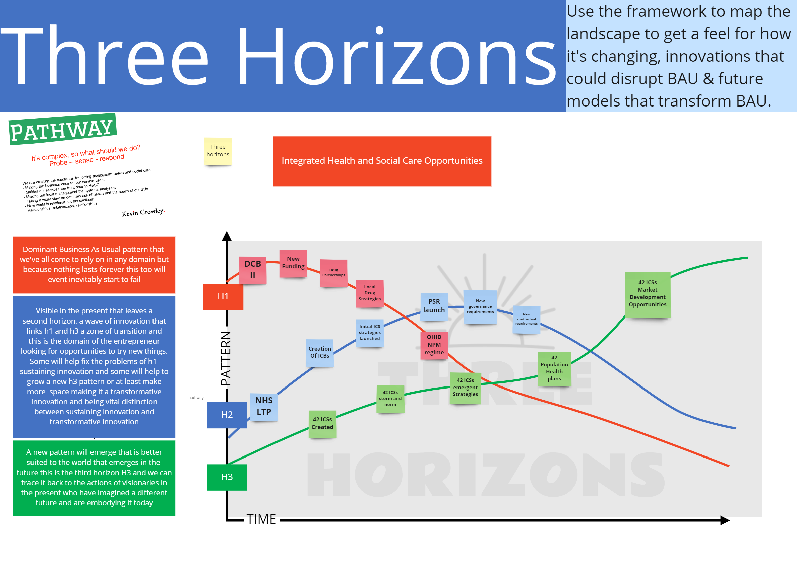
Notes:
I think we are creating the conditions for joining mainstream health and social care
Making the business case for our service users
Making our services the front door to H&SC
Making our local management the systems analysers
Taking a wider view on determinants of health and the health of our SUs
New world is relational not transactional
Relationships, relationships, relationships

Slide 18
I’m here to help if you get stuck! e kevin@kevincrowley.co.uk w www.kevincrowley.co.uk t 07511 585001

