Slide 1
People who experience drug/alcohol harms – taking a population health approach
Zoe Rice
Transformation Manager for Population Health Management

Slide 2
Population Health Management (PHM) is the way we work together to understand and improve the health of people and communities using joined-up health and social care records.
See ‘whole’ people
Understand the needs of our population
Our health and care system as a whole

Slide 3
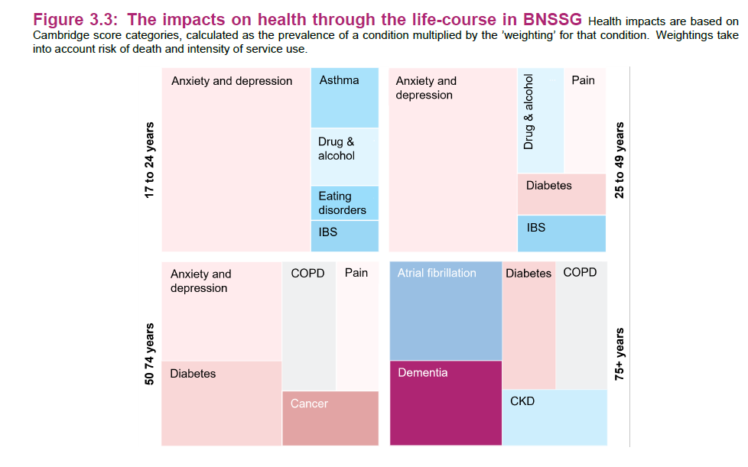
In Bristol, North Somerset, and South Gloucestershire…
Source: BNSSG Strategic needs assessment

Slide 4
What we’ve been doing
Analysing our linked-data. The ICB contribution to CDP Needs Assessments
Connecting people and building relationships
Advocating for a structural home for drugs/alcohol at the ICB
Influencing ICS priorities

Slide 5
Reflections
PHM has been a useful approach for getting started
Now is the right time
There is so much we can do

