Slide 1
Staying Alive: Reviving The NHS Inpatient Detox Provision
Jon Shorrock
D&A Services Manager for Avon & Wiltshire MH NHS Trust and Chair of the NHS Inpatient Network

Slide 2

Background
Introduction
The fallout across the sector from the 2012 Health and Social Care Act has had the biggest impact on NHS inpatient detox units.
In 2008 London had 8 NHS inpatient drug and alcohol units – in 2020 there are none with only 5 remaining across England. [Our early findings show in 2008 there were 21 NHS units]
Transfer of budgets to local authorities has resulted in commissioning via frameworks, rather than block contracting which is the usual form of purchasing [such as CAMHS Tier 4 units, Forensic inpatient units, Perinatal inpatient units].
Clinical decision making is largely undertaken by local panels and focuses on cost, inpatient detox is perceived as “expensive”. Some areas have none or very little Tier4 budget.

Slide 3
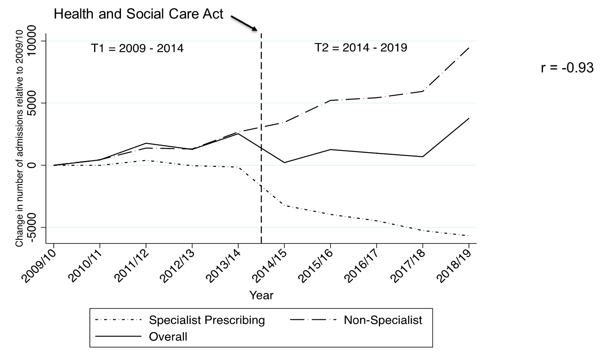
Impact on activity
Introduction
Annual changes in the number of admissions by care setting relative to 2009/10. (Reference vertical line indicates period of policy change) Phillips et al., in press

Slide 4
Impact on Quality
Impact
Healthcare Commission 2009 – 77% IP addiction units “good” or “excellent”
Care Quality Commission 2017 – 72% (49/68) were “unsafe”, 12% required enforcement action
  Not addressing clinical risk
  Not following clinical guidelines
  Poor medicines management (inc. controlled drugs)
  Insufficiently trained staff
  Lack of essential employment checks

Slide 5
The Uniqueness of NHS Inpatient Units
NHS Inpatient Units
Hospital site based.
Strong, multi-disciplinary team
  Psychiatry
  Psychology
  Nursing
  Pharmacy
  Social Work
  Other support such as
    Physiotherapy
    Dietician
    Occupational Therapy
Ability to respond to those with most complexity and recovery resistant [including MHA detention] with successful outcomes.
Contribution to addiction psychiatry training posts.
CQC rated Good or Excellent.

Slide 6
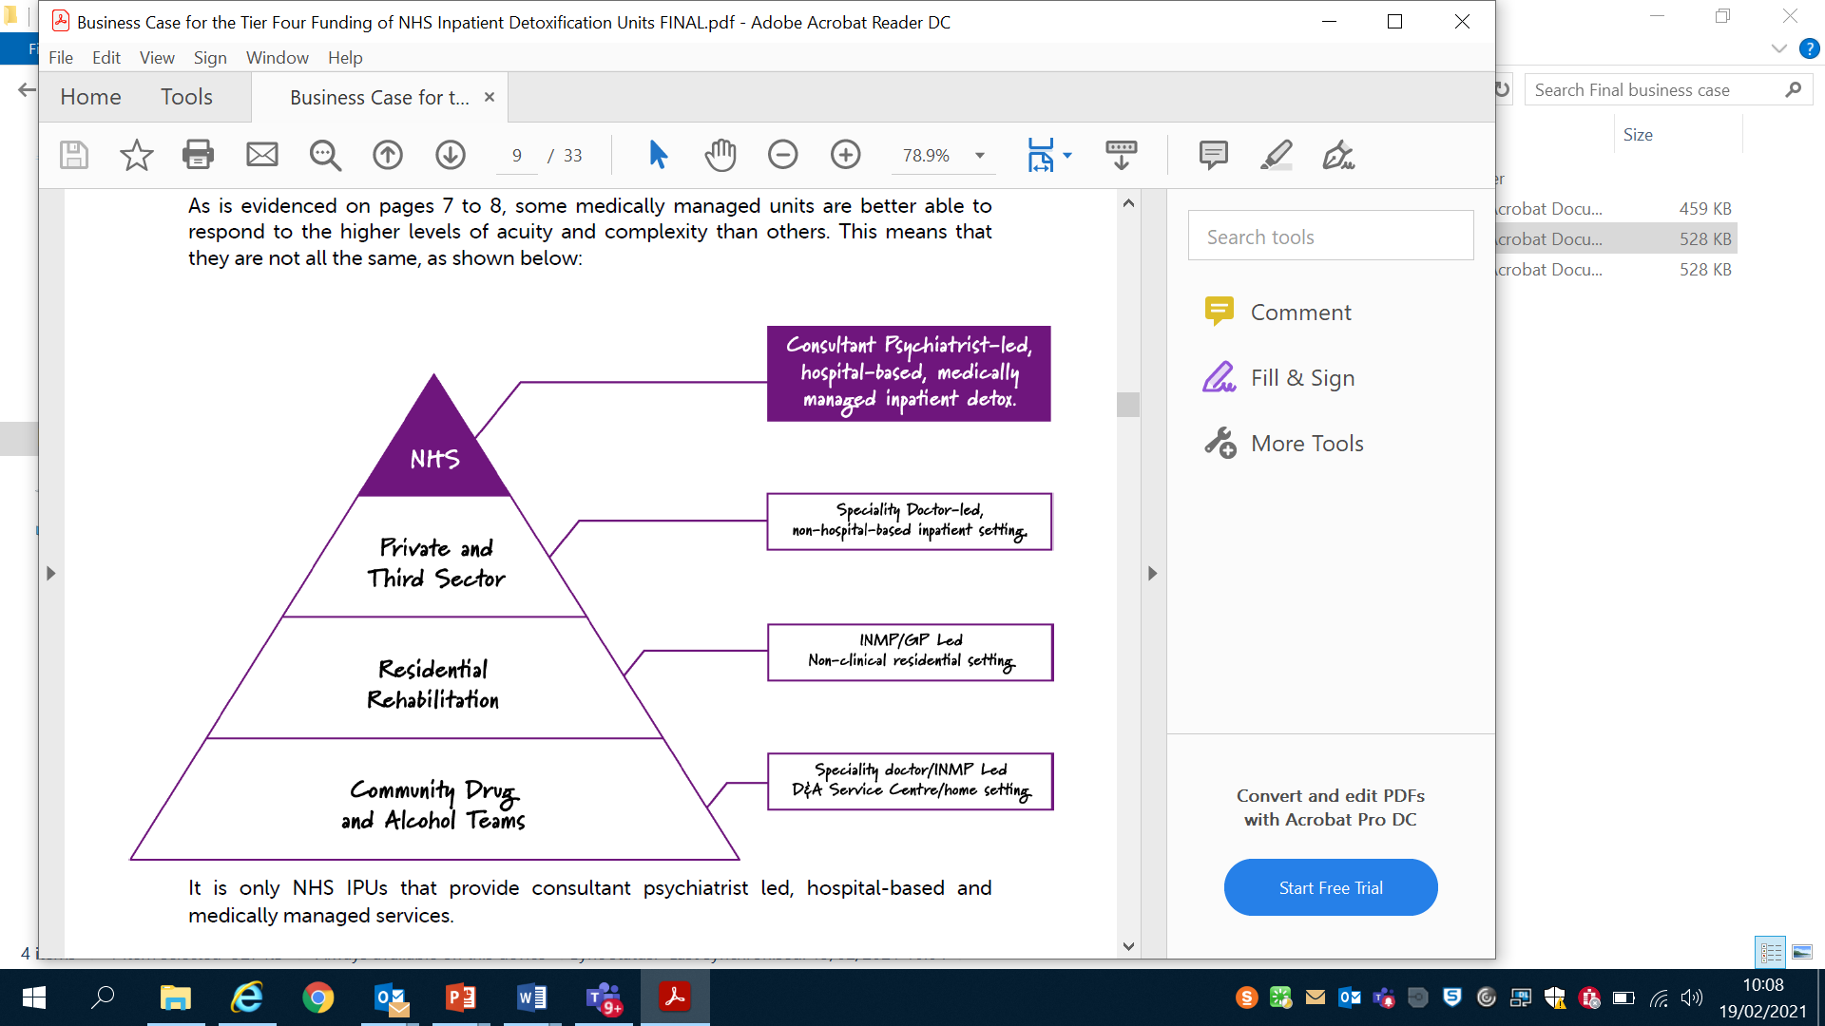
The level of interventions and acuity of work undertaken by NHS Inpatient Units
NHS Inpatient Units

Slide 7
Risks and Challenges
Risks & Challenges
Impact on the wider health economy – acute trusts, MH trusts, A&E departments.
Continued methods of funding and commissioning places all the risk with the provider.
Further reduction in training posts [60% reduction since 2006].
Ageing cohort with complex needs will lead to poorer health outcomes and premature death if access to this pathway is removed.
SCAN definition of medically managed and medically monitored is unchallenged and often self-applied.
Failing standards recorded by CQC within non-NHS inpatient units puts service users at increasing risk of death and/or iatrogenic harm.
Recruitment and retention of professional registered staff across the sector is compromised.

Slide 8
From problems to solutions?
Finding a solution…
Firstly, to recap all 5 NHS Inpatient Units are financially precarious and what we will all lose if a solution is not found:
Those with the most complex needs will have a greatly reduced opportunity for recovery and in many cases will experience premature death
The impact is felt across the health, social care and criminal justice systems by experiencing increased burden and cost
Expertise and learning will be lost that will take years to regain should they be re-established
Further reductions in the training of the future Consultant Addiction Psychiatrists and the like, which are already in short supply.

Slide 9
Continued…
Finding a solution…
The current funding system is not working and is not an option for the NHS detox units to be viable going forwards
It has been suggested that secure funding could be formulated at a local level through STPs / ICS or in some areas via devolution.
Our own assessment is that due to the acuity of the work that we as NHS inpatient providers do and similarities exist with inpatient perinatal we should be commissioned via NHSE

Slide 10
What have we done? …
Finding a solution…
We formed a network as a sub-group of the NHS Alliance
We made our primary objective was to find a sustainable funding solution for the 5 remaining NHS inpatient units
Developed a robust business [backed by case studies] for consideration for specialist commissioning and have made application for this to occur
Worked with the NHS APA communications company, Brightsparks, to develop and deliver a coherent and targeted campaign via social media and mainstream media – the current inpatient funding is at least in part traceable to this campaign
Raised our profile and challenges nationally through Collective Voice, PHE, NHSE, charitable organisations and through the DCB Review Pt 2

Slide 11
What do sustainable funding solutions look like?
Finding a solution…
Substantial Sector-wide increased funding for drugs and alcohol as a result of the Dame Carol Black Review that accounts for sustainable provision for Tier 4. Likelihood is unknown.
STPs & ICS work to find local / regional solutions through schemes such as RADAR & IOU’s. Limited success in some areas.
Submission of NHSE application for NHS IPUs to be funded via specialist commissioning. Progressing positively.
A LA / PH regional funding model for Tier 4 using the NHS IPUs as the vehicle

Slide 12
New Money – problem solved?
Finding a solution…
We celebrate the success of the NHS IPN campaign and how we have influenced the clear line on spending for inpatient detox with the £80m 1 year spending uplift
A healthy amount to share approx. £1m per PHE region – we are engaging with this process locally, regionally and nationally
Alcohol is included equally
Commissioners are working hard to develop regional and sub-regional commissioning arrangements, which will create a blueprint for the future and possibly make Tier 4 more sustainable going forwards?
This is 1 year funding only and we hope the DCB Pt2 and the spending review will mean greater long-term security
The future does look brighter but there is a long way to go

Slide 13
From all of us at the NHS Inpatient Network
www.nhsapa.org/ipn
#KeepTheFewNHSIPUs

