Slide 1






Slide 2

Residential Rehab…a snap shot

Slide 3
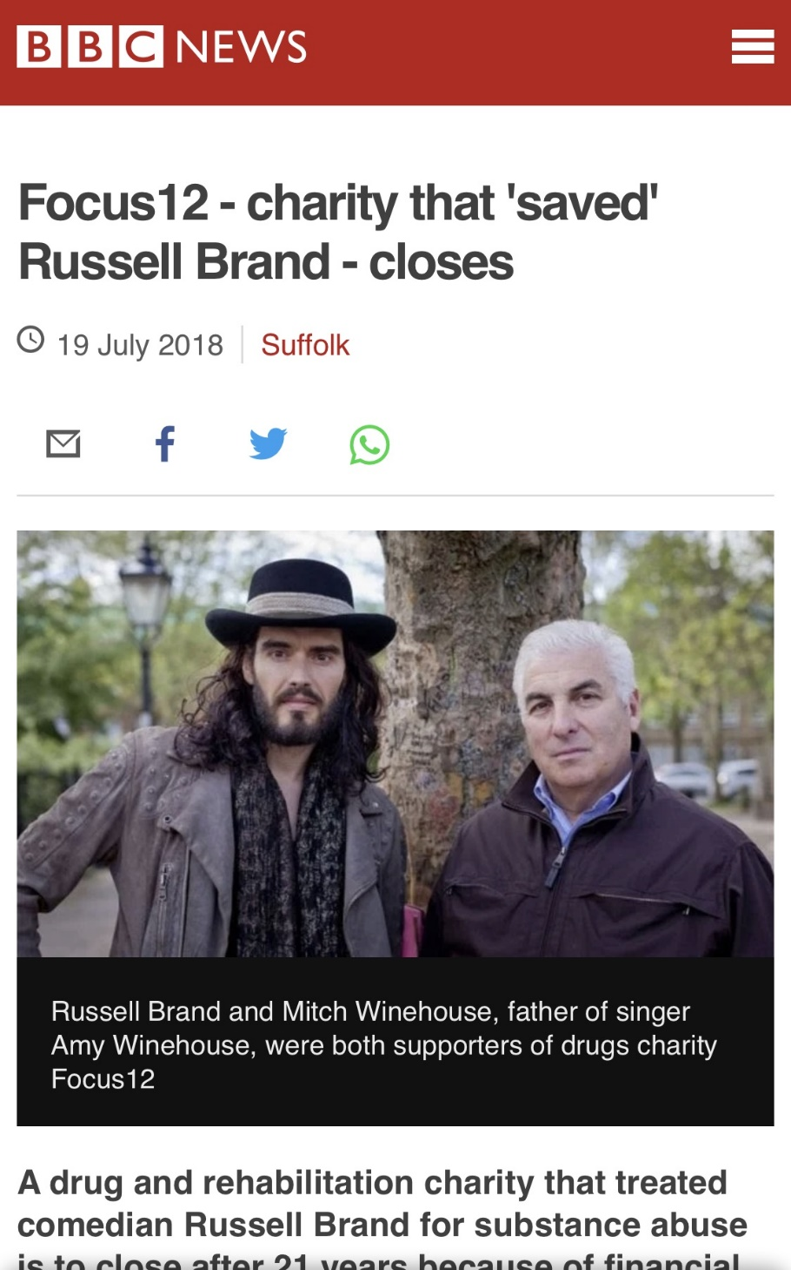
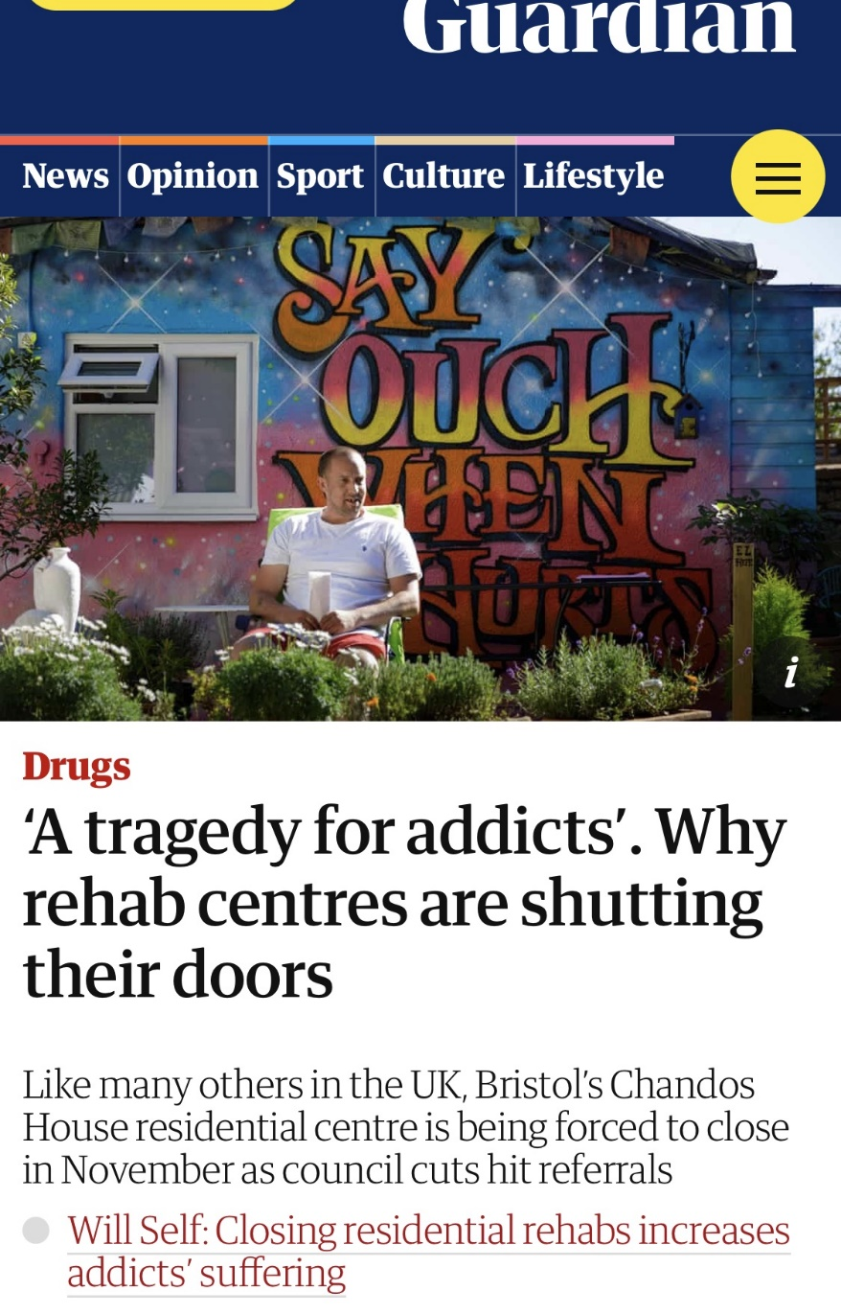
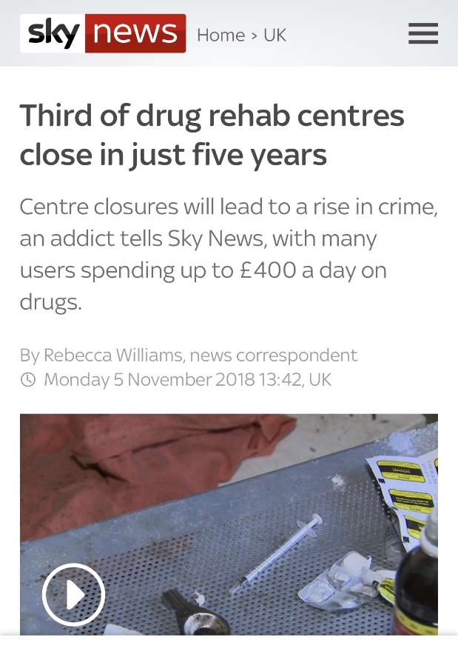
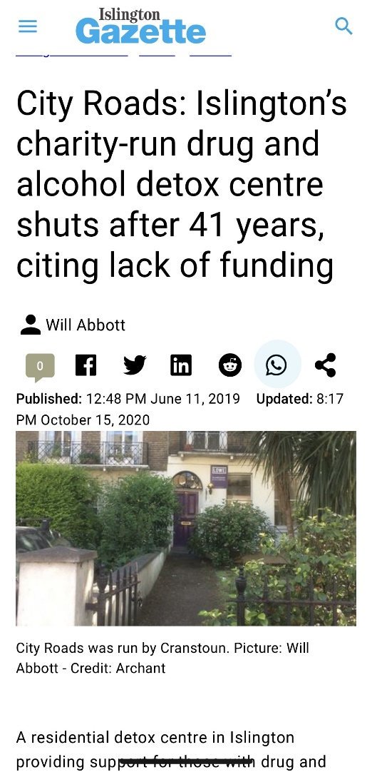
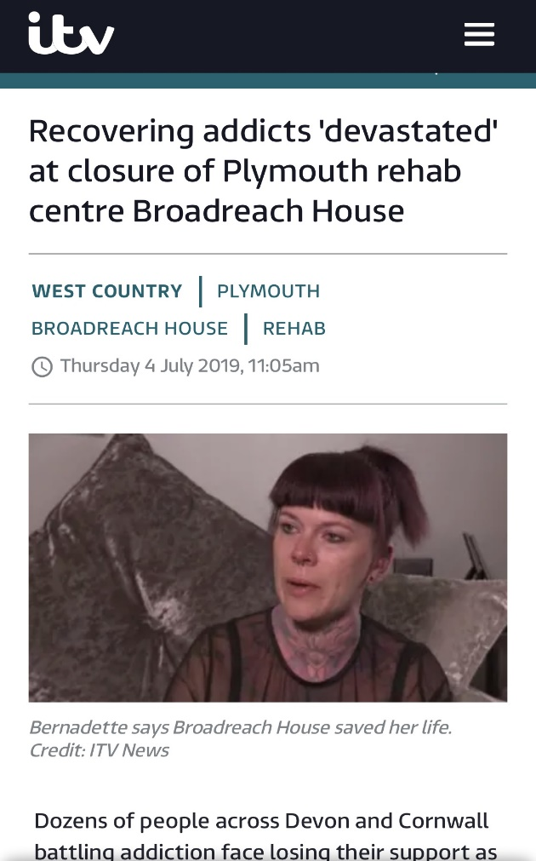
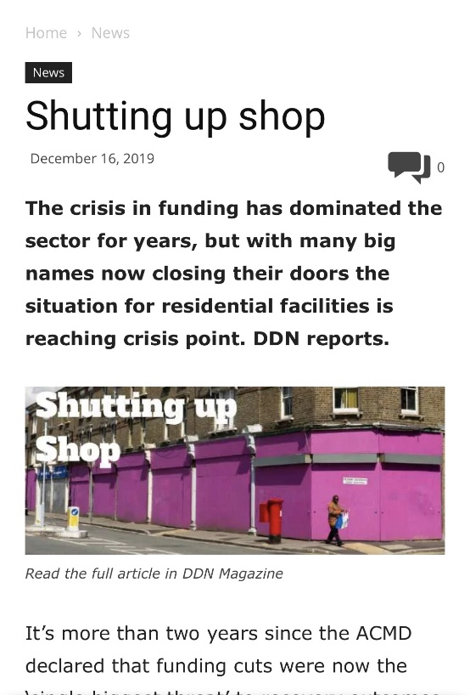

Slide 4

No more need?

Slide 5
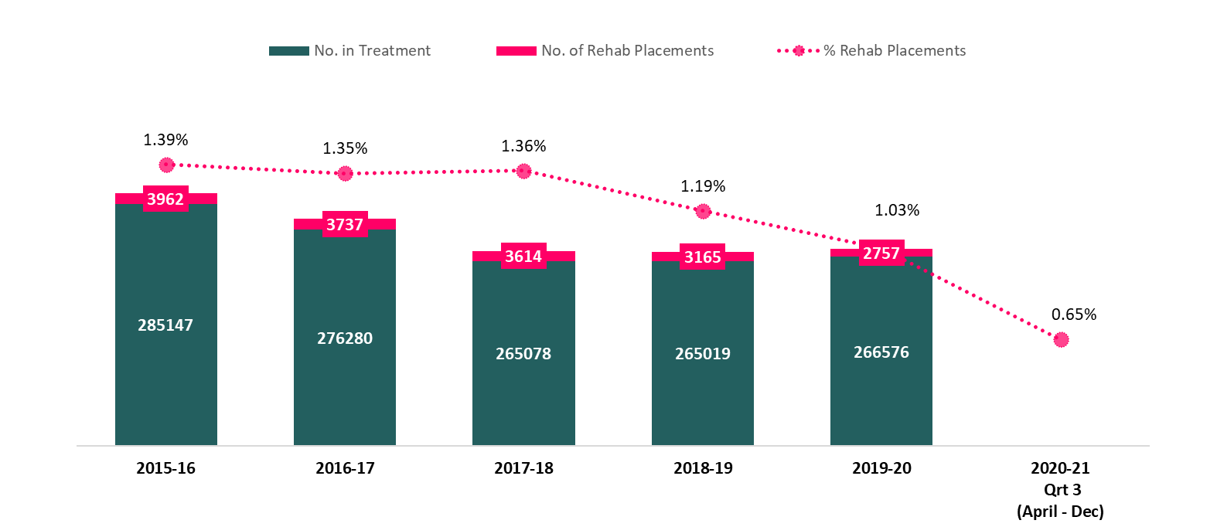
Last 5 years…proportion of rehab placements
Data Source – NDTMS Report Viewer – National (Adult Activity Report - Partnership)

Slide 6
Choices – challenges over last 5 years
Occupancy!!!
Complexity of clients
Funding
Approved provider / tender process
CQC

Slide 7
Occupancy trends…
Data Source – NDTMS Report Viewer – National (Adult Activity Report - Partnership)

Slide 8
This year so far
Data Source – NDTMS Report Viewer – National (Adult Activity Report - Partnership)

Slide 9
2019-20 (1st April 2019 to 31st March 2020)
5% (7 out of 150) LA’s placed zero clients into Rehab
Fewer than 5 clients placed
23% (35 out of 150) LA’s placed less than 5 clients into Rehab
Postcode Lottery?
No placements
Data Source – NDTMS Report Viewer – National (Adult Activity Report - Partnership)

Slide 10

Covid
Occupancy
Funding / fundraising

Slide 11

Some positives…
Collaboration
Sharing best practice
Raising standards
Response to Covid

Slide 12
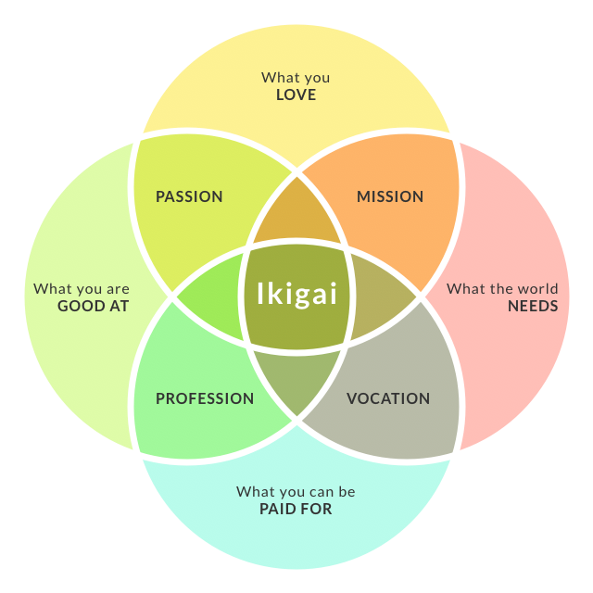

Slide 13

Registered charity no. 1075433

