Slide 1

Collective Voice
Residential Rehab and Detox - Mapping a way forward for Tier 4
Andy Symons
TP Oxfordshire
Senior Ops & CQC Reg Manager

Slide 2
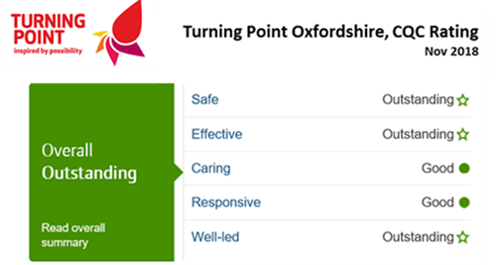
TP Oxfordshire….
Four Treatment Hubs
Opiates – Core OST & Shared Care (1489)
Alcohol - Dedicated Alcohol Service (579), Non OU (404)
Outreach / In-reach – Homelessness, FSP, Community
Collaboration – Mental Health, FSP, Criminal Justice, Hep C Treatment , Hospital Liaison
Fluffy Bits - Refresh Café, Recovery
House, Peer Mentoring,
Growing our Community…..

Slide 3
Oxfordshire Tier 4 Framework….
Oxfordshire Tier 4 Framework – Detox / Rehab…..
Local 12 Week Assisted Withdrawal Programme
Virtual Funding Panel – fortnightly
Past Traditional Community Care Roles – separate function, formal reviews etc
Fresh Integrated Tier 4 Approach – all staff complete, clear package agreed with aftercare
Collective Service Responsibility…

Slide 4
Oxfordshire April – Dec 2020….
Community Treatment – 111 OU Successful Completions, 52 Alcohol Com Detox,
Residential Out of County Treatment – 85 placements
Criminal Justice Pathway – Community, Prison, Residential, Community…
Rough Sleepers – capturing the moment
Specialist Off Panel Placements – Mother & Baby, Autism, Dual Diagnosis
Complexity – matching Residential Treatment with those who most need it

Slide 5
What’s Worked for Us…..….
Fresh Approach – Bespoke care packages…
Service User Aspirations – not everybody likes Sausages…
Collaboration – we love working with services who want to with us…
Solution Focused – flexibility, flexibility…
Joint Ownership – working together builds Trust…
Investments pays dividends – time, money…
Service User Outcomes – lasting sustained recovery

Slide 6
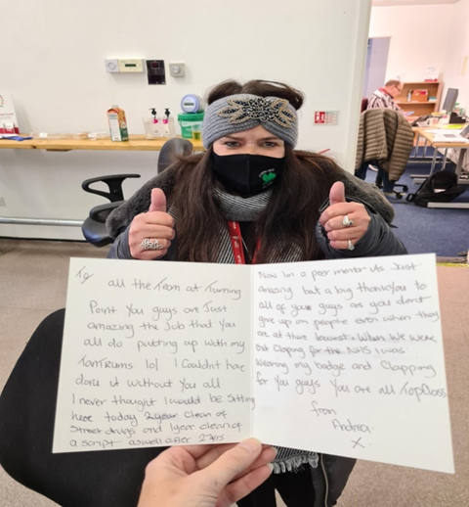
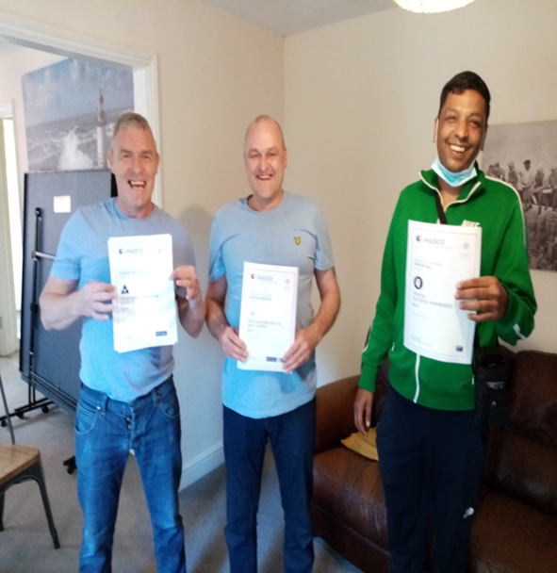
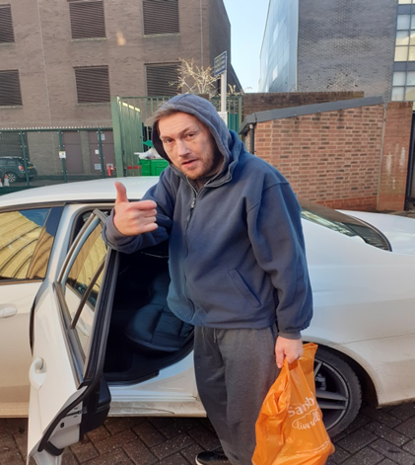

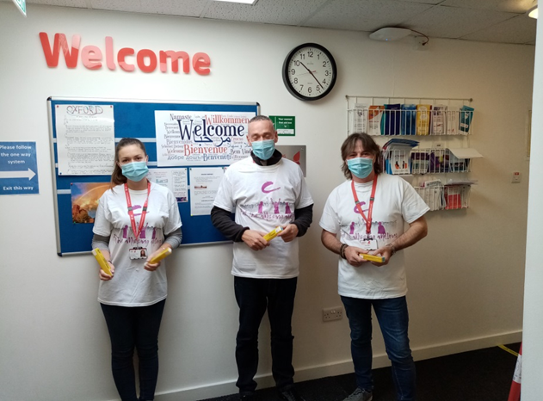
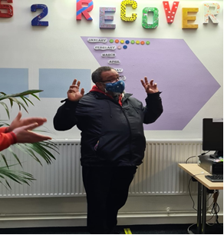
What makes us Smile……
Thank you……..
andy.symons@turning-point.co.uk

