Slide 1
Benzodiazepines
Steve Taylor, Addiction & Inclusion
18 August 2022
OFFICIAL-SENSITIVE

Slide 2
Benzodiazepines in drug poisonings, England and Wales

Slide 3
Benzodiazepines in drug poisonings, England and Wales

Slide 4
Benzodiazepines in drug poisonings, England and Wales

Slide 5
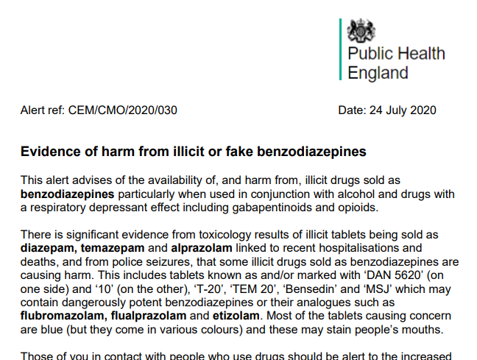
2020 national alert and what we see now
Diverted UK medicines
Medicines from other countries
Illicitly manufactured medicine clones (medicinal benzos)
Illicitly manufactured medicine copies (unlicensed benzos and analogues)
eg
Blue ‘diazepam’ tablets
‘Xanax’ bars

Slide 6
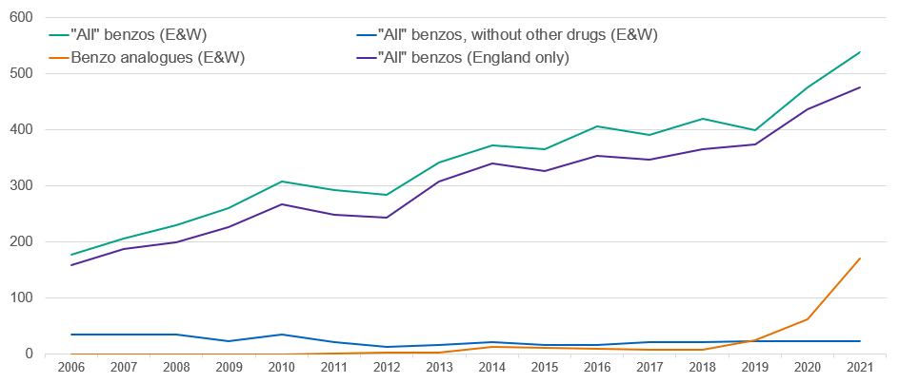
Benzodiazepine users as a proportion (%) of all in treatment, England only

Slide 7
Current UK guidelines
“Prescribing benzodiazepines for dependence is more likely to be appropriate in secondary care and will normally be provided as a time-limited detoxification programme”
Little evidence that long-term substitute prescribing reduces harms
There is evidence that long-term prescribing (especially of more than 30mg diazepam equivalent per day) may cause harm
So, continue a current benzo prescription but convert to diazepam and gradually reduce dose to zero
Only very rarely should doses of more than 30mg diazepam equivalent per day be prescribed
Most patient with high levels of confirmed dependence of benzodiazepines can be stabilised and do not experience severe withdrawals/seizures on 50mg diazepam

Slide 8
Why maintenance stopped
Over-use
Tolerance develops to therapeutic dosing so “maintenance” means escalating doses
Long-term memory and other cognitive issues
Also reports of paradoxical violence

Slide 9
“Guidelines, not tramlines”
But orange book is “guidelines not tramlines” – expect ~10% of practice/patients to step outside … as long as individually assessed, carefully documented, cautiously provided in response to need, and monitored for benefit and harms
“there will be exceptional cases, following careful assessment, where individuals with dependence may be provided with longer-term prescribing of benzodiazepines. Factors such as long duration of previous benzodiazepine prescribing, clear evidence of relevant pre-existing and concurrent comorbid mental health problems, or clear deterioration following previous adequate benzodiazepine detoxification are factors that clinicians may consider are relevant in such cases. Any such longer-term prescribing of benzodiazepines should adhere to general principles of management of dependence (including identifying clear indications of benzodiazepine dependence, clear intermediate treatment goals and milestones, regular review of the approach and use of methods to prevent diversion).”

Slide 10
What is OHID doing?
Evidence review – found little
NIHR bid for RCT on maintenance – shortly
Guidance review – considering
NICE – maybe?

Slide 11
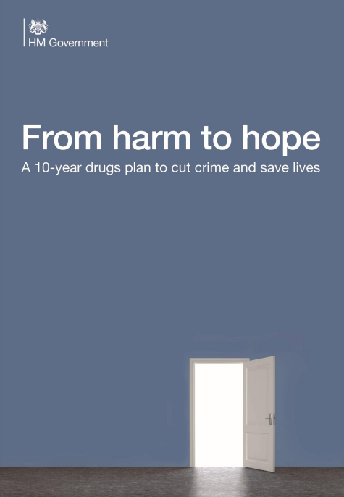
The drug strategy and support arising from it
New money (in addition to requirements to maintain public health grant): supplemental grant, rough sleepers
Increased workforce size and competence
More capacity, more people in treatment, more non-opiates

