Slide 1

Benzodiazepines
A Humankind approach
18th August 2022
Dr Roya Vaziri, Executive Medical Director
MBBS MRCSI DFFP DRCOG MRCGP

Slide 2
Key learning from last 25 years of practice
Benzo withdrawal is hard to predict and manage, each person’s experiences are different
Withdrawal symptoms can be similar to initial symptoms that were being managed and/or psychologically challenging requiring preparation and bespoke interventions
Polysubstance Use compounds an already complex situation
Toxic interactions cause death
Inpatient solutions work for some, but with care we can manage detox in the community
Strong Therapeutic Alliance
Needs a different approach to the one used for opiate or alcohol reduction and withdrawal
Harm Reduction approach saves lives
Lived experience and hope around the use and / or a future without Benzos is needed
Shared Decision making

Slide 3
Class of medication
Acts: Central Nervous System
GABA Receptor (Gamma-aminobutyric acid)
Examples of Some of the effects:
Hypnotic – Sedative (sleep inducing)
Anxiolytic – Relief of Physical/ Psychological anxiety
Anticonvulsant – anti “Fits”/ Seizure
Muscle Relaxant
Wide Spectrum of potential effects with each Benzodiazepine including differences in:
Duration of Action; Potency
Tolerance
Dependence
Toxicity : Interactions / potentiated with other CNS depressants eg opioids, alcohol

Slide 4
Why do we prescribe or use Benzos?
Prescribed for or used
Anxiety
Insomnia
To undertake procedures (conscious sedation)
Seizures
Get a better effect from other drugs/substances
Reduce the effect from other drugs or reduce the effect of withdrawal from other drugs/substances
Dependence, withdrawal symptoms various from Psychological to Physical e.g.
Nightmares, sleep disturbances
Intrusive Memories
Panic attacks
Notes:
Each person who is prescribed or uses Benzodiazepines will have a unique experience based on the type / quality / dose / mode / length of action and their psychosocial circumstances

Slide 5
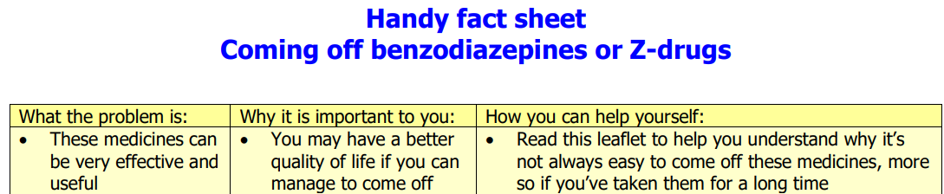
Our approach
Immediate risks of harm eg overdose Harm Reduction
Be curious, explore and challenge (the status quo for the practitioner as well as the person taking the benzodiazepine)
Check in on fear and stigma
Needs Based assessment (strength based and resilience)
Collaborative risk assessment and management plan
Risks of doing something / risks of not doing something
Shared Decision making
Interventions
Psychosocial ( eg sleep hygiene)
Psychological (eg CBT)
Prescribing medication

Slide 6


Our prescribing practice
Humankind Prescribing Guidelines include reference to:
  Orange Guidance - Drug misuse and dependence UK guidelines on clinical management Updated 2017
  NICE Clinical Knowledge Summaries : Benzodiazepine and z-drug withdrawal Last revised in April 2022
  The Ashton Manual (Prof Heather Ashton – Revised 2002)
  Clinical Institute Withdrawal Assessment Scale -Benzodiazepines (CIWA-B) and Monitoring Form
Prescribing Formulary Bespoke Prescribing Reports
Harm reduction information
Shared decision making with ‘choice and medication’ information leaflets

Slide 7
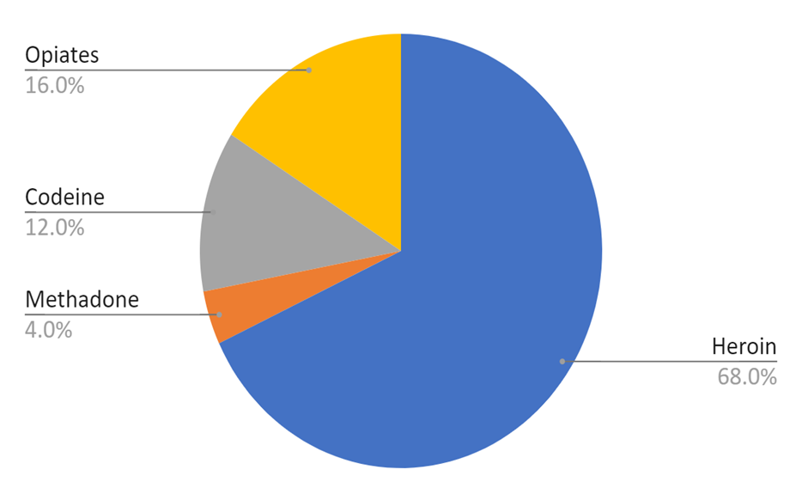
‘Service S’ – short summary
Implemented April 2020 (mid-pandemic)
25 people on inherited ‘maintenance’ benzodiazepine prescriptions
Mean age 47 years
Male 80:20 Female
All in one Hub
All prescribed OST(80% meth; 16% bup)
Diazepam n=24
mean daily dose 16.0mg (4-30mg)
Nitrazepam n=6
mean daily dose 16.2mg (5-35mg)
Primary substance:

Slide 8
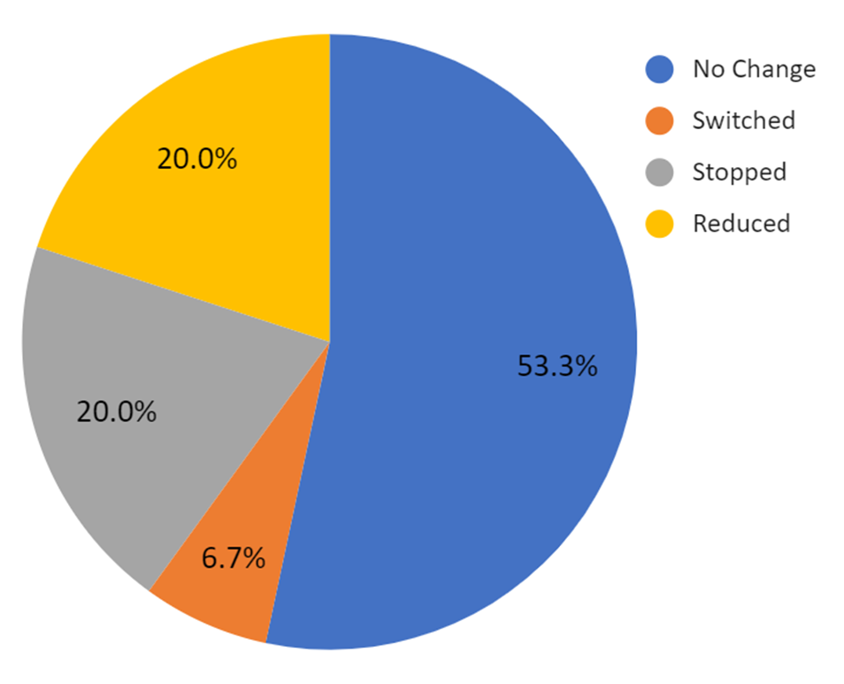
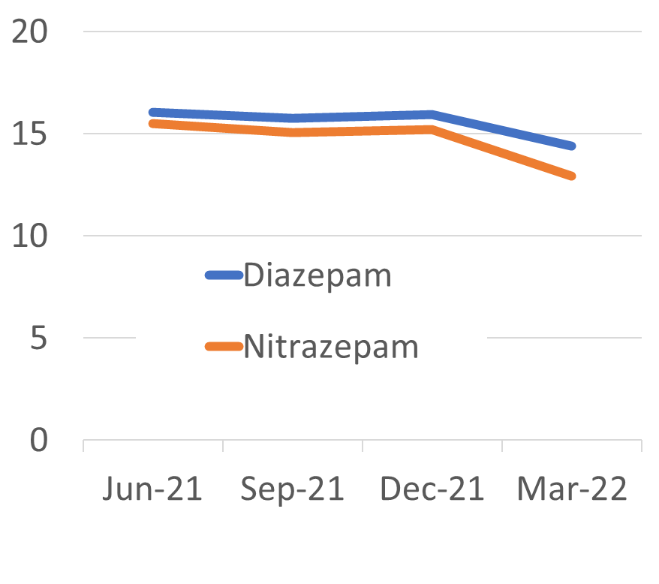
Changes since work started in Service S
Summary of changes (March 2022) Mean daily dose changes

Slide 9
Early learning from Service “S”
Culture and practice - expectations of the workforce and the community of people takes time to understand - in this scenario challenges in inheriting a system and exacerbated by Pandemic
Passionate driven individuals in workforce advocating for people using benzodiazepines to achieve a shared decision making
There is much more analysis to be done on this cohort (people who are also prescribed OST) – early first glance data

Slide 10
Additional learning
Benzo withdrawal is hard to predict and manage, each person’s experiences are different
Adequate time to build therapeutic alliance for engagement and intervention
Polysubstance Use compounds an already complex situation
Inpatient solutions work for some, but with care we can manage detox in the community
Lived experience and hope around the use and / or a future without Benzos is needed
Types Benzodiazepines, confirmation tests and quantifying dose used
Expertise of the workforce on Benzo and Polysubstance use
Research into different cohorts of people – evidence based practice e.g. Prescribing options
Notes:
Toxic interactions cause death
Harm Reduction approach saves lives

Slide 11
Next steps, solutions to consider and discuss today ?
Review specific training needs re Benzodiazepine and Polysubstance use
Interventions for specific Benzodiazepine PSI or Group work
Coroners/ Police testing of Benzo linked with Local and National Intelligence re illicit availability and type. E.g. Amnesty box linked with Drug Checking
Reversal medication – future formulation changes to support community delivery
Lived Experience, specific Benzo “champions” in the community. Film and the arts.

Slide 12
Thank you
Roya.vaziri@humankindcharity.org.uk

