Slide 1


Benzodiazepines - Webinar
Dr Jeffrey Fehler
Consultant Addictions Psychiatrist
Clinical Director, Addictions Directorate

Slide 2

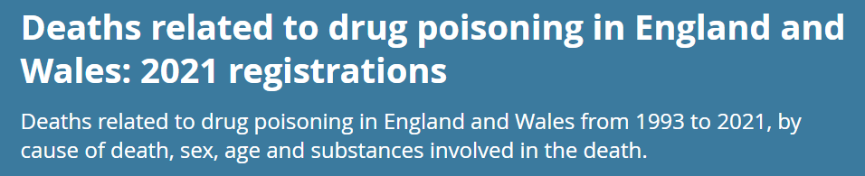
Benzo’s and analogues
ONS (2021, England and Wales)
Increasing numbers of drug deaths involving benzodiazepines in 2021 (a rise of 13% cf 2020, but that was 19% rise cf. 2019)

Slide 3

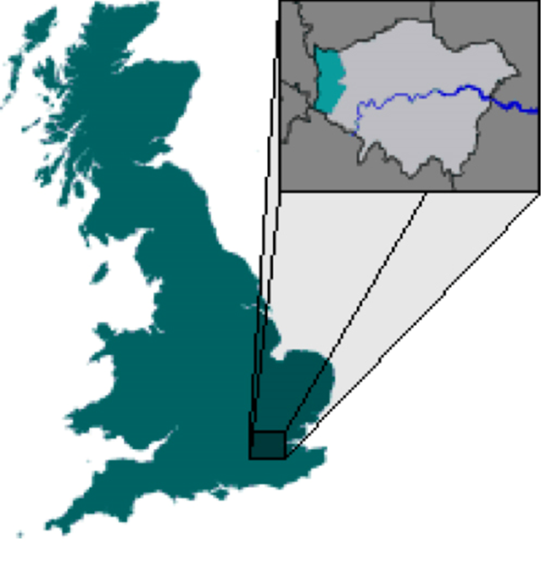

CNWL scoping exercise BDZs, 2021
    No increase in numbers seen during pandemic
    All used other substances
    Decrease in 2020-21 in 4/5 services - probably reflecting service provision during pandemic
    Broad consensus (but not all) that illicit BDZ use is more prevalent than is recorded or known by services
    Common views by clinicians of clients under-reporting illicit and prescribed BDZ
      Some reports of over-reporting
      Diazepam remains illicit BDZ of choice Alprazolam use increasing
      MIXED PICTURE…
This Photo by Unknown Author is licensed under CC BY-NC-ND

Slide 4
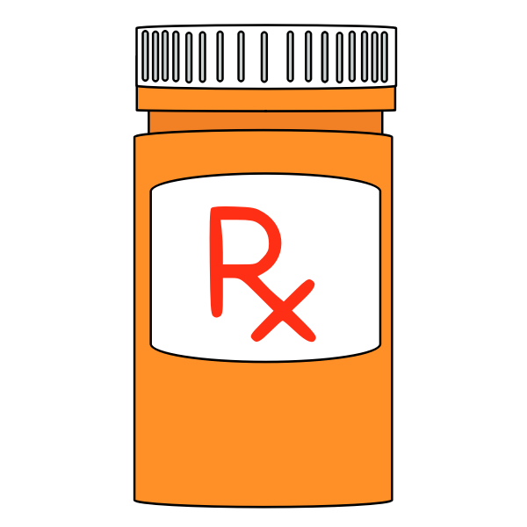

CNWL scoping exercise, 2021
    Prescribing
    Variations broadly (but not always) based on lead clinician philosophy, ‘commissioning policy’, role of CNWL in partnership
    OPTIONS:
    No prescribing at all - referred to GP
    Limited prescribing: e.g. complex clients, cases too complex for GP to manage
    BDZ prescribing for all dependence

Slide 5
Typical BDZ/Hypnotic Guidelines
    Use lowest BDZ/hypnotic dose for briefest time, e.g. 2-4 weeks
Use only 1 BDZ
Dose used should be in therapeutic range (i.e. within BNF limits)
Only use in acute self-limiting situations/conditions
Only use for severe symptoms (never mild symptoms)
Reduce gradually after long term use
Do not use in those with a history of addiction
BUT I DO FEEL THIS IS OUR BUSINESS WHEN ADDICTION DEVELOPS

Slide 6

Next Steps
    Education - holistic management
    Some form of uniformity in approach …
    Attitude change
    Collective ownership
My Email: jeffrey.fehler@nhs.net

